Slide 1


Code Adoption
Significant Changes to the 2024 IRC, IBC, and IEBC
December 18, 2025
Ryan Courtright, Asst. Chief of Risk Reduction
Beniah Naylor, Building Inspector II
Justin Befort, Plans Examiner

Slide 2

Thank You!

Slide 3
Agenda
Updates and Reminders
History of Code Adoption in Manhattan
Overview of the Code Development and Adoption Processes
Updated Adoption Schedule
Significant changes
2024 International Residential Code
2024 International Building Code
2024 International Existing Building Code
Review Current Amendments

Slide 4
Updates and Reminders
General Contractor, Demolition Contractor, and Electrical Contractor, and Tradesperson Licenses expire December 31, 2025.
Deadline for Renewal is January 10,2026.
License renewal is completed online through our Contractor Portal
12 CE hours (6 hours- Manhattan Codes) required for general contractor and tradesperson license renewal.
New city wide permitting and licensing platform, Opal (Oracle) is under development and will go live in 2026.

Slide 5
Importance of Updating Building Codes
The average person spends nearly 90% of their lives inside buildings
Model codes set minimum requirements for design and construction
Updating ensures new technologies, materials and methods can be incorporated into the next generation of buildings
Strong up to date building codes are our first and best line of defense against natural disasters.
Learn from the past and reduce future risks.

Slide 6
Manhattan Code Adoption History
Nov. 17, 1908 Ordinance #124 Set forth the requirement for building permit issuance prior to construction taking place. Also set general construction requirements especially combustible structures within fire districts
Nov. 24, 1925 Ordinance #629 Creates building inspection office and further outlines construction requirements
April 1, 1941 Ordinance $1176 Adopts “latest edition” of National Building Code (NBC)
With only one exception (1967), Manhattan has adopted updated construction codes every three years.

Slide 7
Code Development and Adoption
Developed by two international organizations
International Code Council
National Fire Protection Association
Updated every 3 years
City Commission must adopt the codes by ordinance.
Local amendments to the codes are incorporated into the adoption ordinances.
Meet with various stakeholder groups to gather feedback prior to adoption
City Commission- March 3, 2026
Updated codes would take affect up to six months after adoption.

Slide 8
Currently Adopted
Proposed Update
2021 International Residential Code
2021 International Building Code
2021 International Fire Code
2021 International Existing Building Code
2021 International Mechanical Code
2021 International Plumbing Code
2021 International Fuel Gas Code
2021 International Property Maintenance Code
2021 International Swimming Pool and Spa Code
2009 Energy Conservation Code
2020 National Electrical Code
2024 International Residential Code
2024 International Building Code
2024 International Fire Code
2024 International Existing Building Code
2024 International Mechanical Code
2024 International Plumbing Code
2024nternational Fuel Gas Code
2024 International Property Maintenance Code
2024 International Swimming Pool and Spa Code
2009 Energy Conservation Code (unchanged)
2023 National Electrical Code

Slide 9
Stakeholder Meeting Purpose
Present an overview of the significant changes in the updated codes and give stakeholders the opportunity to provide feedback.

Slide 10
Significant Changes to the IRC
2024 Code Edition
MFD Risk Reduction
Based on 2024 International Residential Code

Slide 11
Organizational Items
Definitions were added for the terms “substantial damage” and “substantial improvement” to reflect the IEBC language.
A definition was added for the term “rainscreen system”.
Many code sections in chapter 3 were moved and given different section numbers.

Slide 12
Section 301 – Design Loads
Wind, snow, and seismic design criteria have changed in some areas of the country – but not here.
We still are at 20 psf snow, 90/115 mph wind, seismic zone A.
Notes:
90 mph “allowable stress design” vs 115 “ultimate winds speed” – one is basically the same as the other in the IRC world for all intents and purposes.

Slide 13
Section 302.3.6 – Duplex Common Areas
Shared accessory rooms in two family structures are now permitted when required fire separation is installed.
Shared accessory rooms fire separation requirements are the same as those normally required for garages, except we will require the door closer to be installed.
Notes:
There was no provision allowing common areas in duplexes or townhomes. We sometimes did what needed done in older homes, but I don’t know that we permitted this in the past on new construction. Nice that they coordinated these requirements to be the same as garage separation. I recommend we make them put closers on those doors, however, instead of amending out that provision like we do for garages.

Slide 14
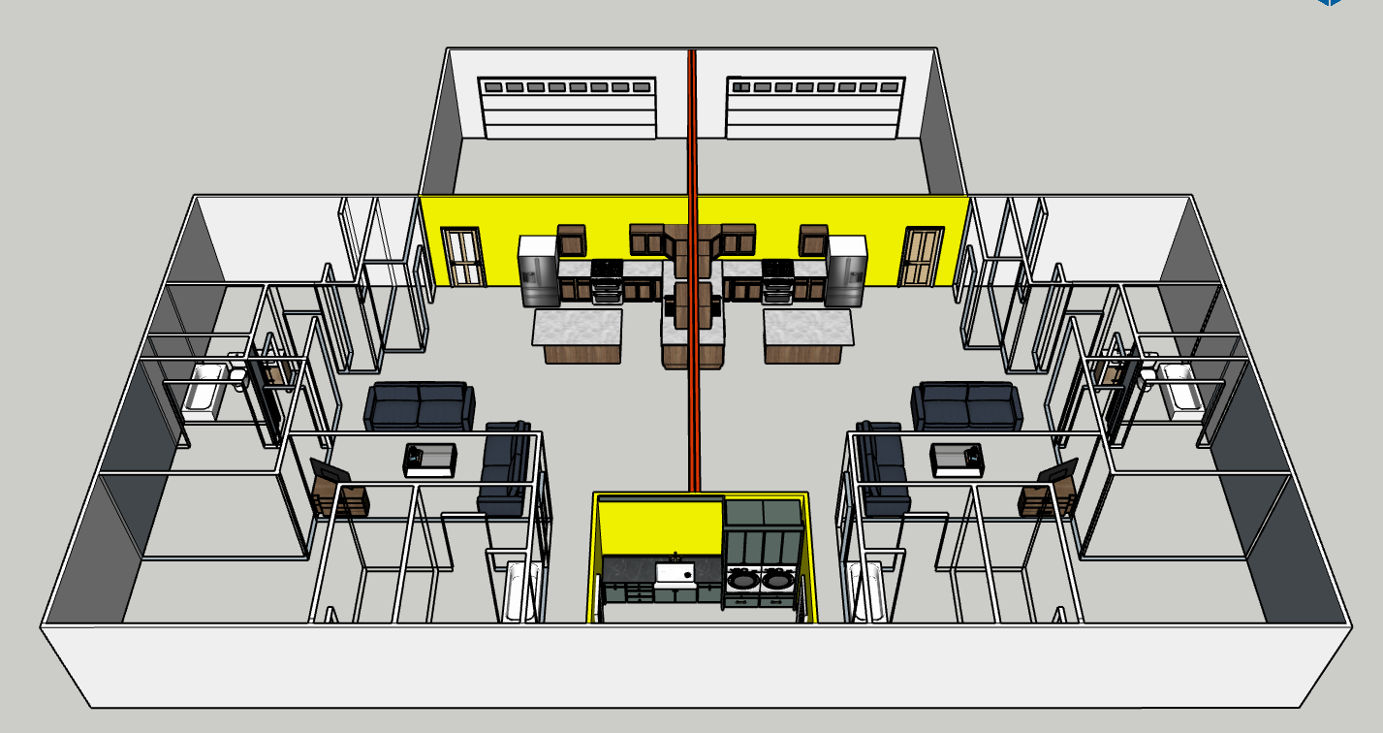
Notes:
Theoretical duplex with shared laundry room.

Slide 15
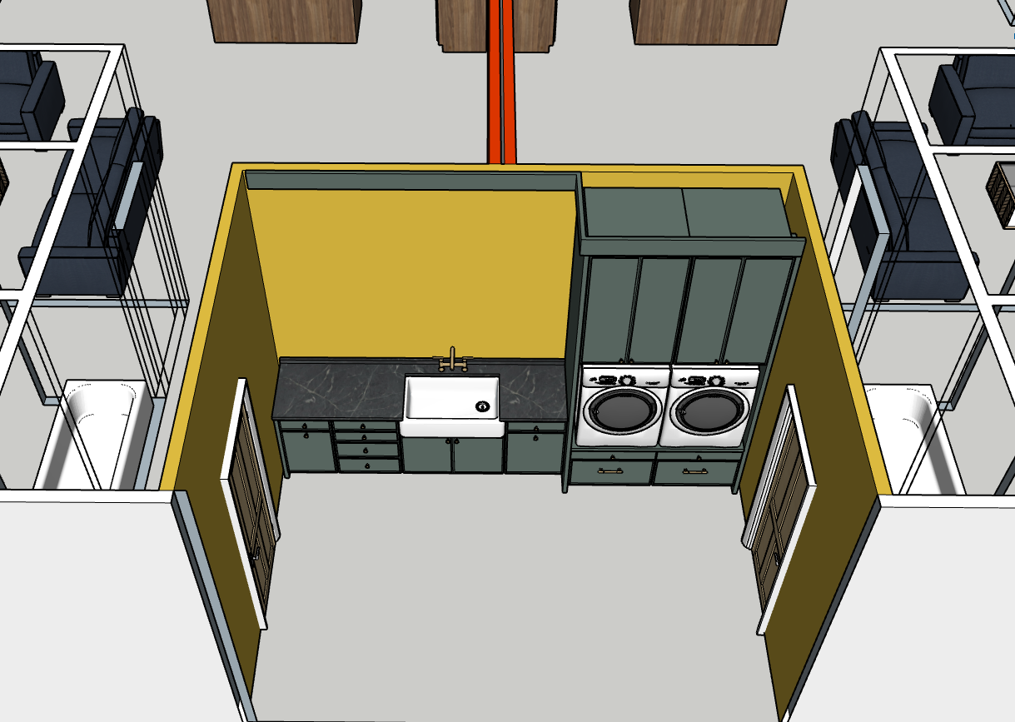
Notes:
Closeup of theoretical laundry room. ½” gyp on walls and ceilings, solid door, closer.

Slide 16
Section 315 – Sleeping Lofts
“Sleeping lofts” added to the code. 13 new sections added to the code that cover ceiling heights, stairs, clear width for egress, and ladders.
A “sleeping loft” is a raised space designated for sleeping that is open on at least one side to the room that the “sleeping loft” is in.

Slide 17
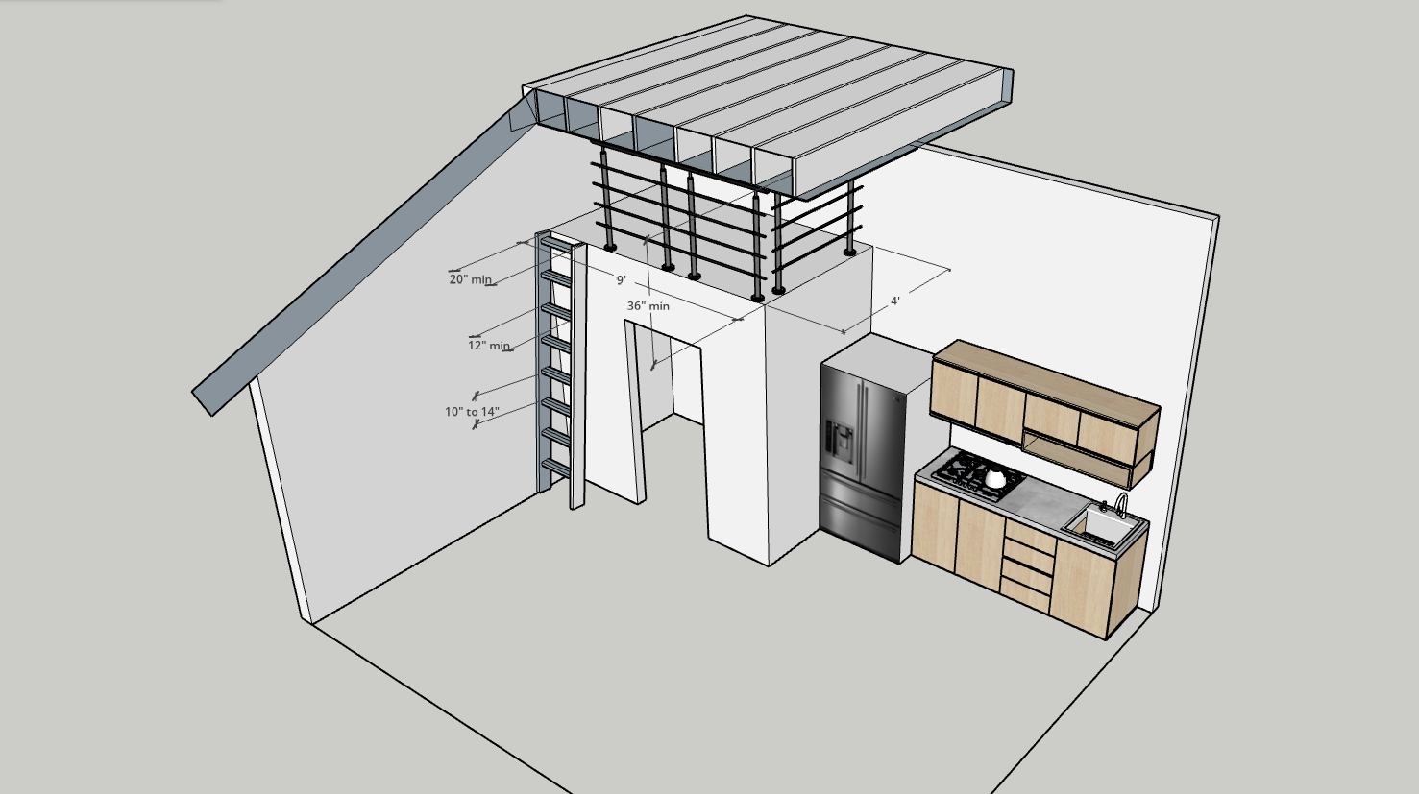
Notes:
Smallest possible loft with steepest possible entry.

Slide 18
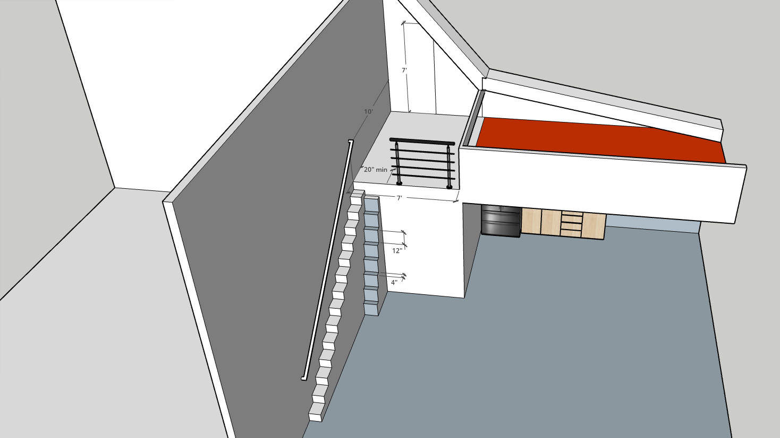
Notes:
Largest possible loft with actual stairs.

Slide 19
Section 318.7.6 – Exception #4
Landings are required for exterior stairways to grade, but if the stair has three or fewer risers, the landing only needs to be 36” wide, not the full width of the stair.
Not allowed on the front door because it is the required egress door, landing must be full width.

Slide 20
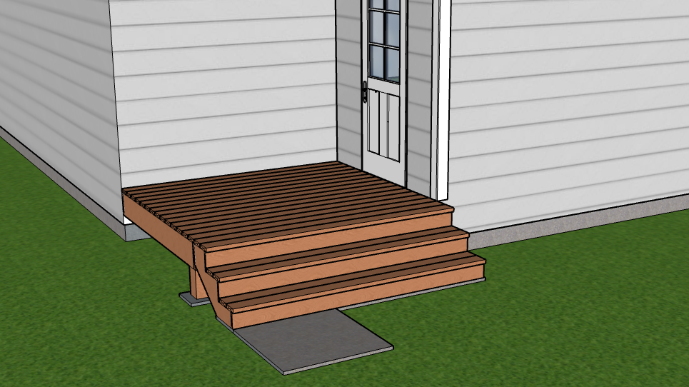
Notes:
Other than main egress door only, not for main egress door.

Slide 21
Section 318.7.9 – Existing Stairways
A stairway in an existing building does not have to be modified to comply with the code for headroom height, width, tread and riser dimension, or landing size for new stairway construction.
Only applies where the existing space and construction does not allow a reduction in pitch or slope.
Amendment
Notes:
Amending language a little just to make it clearer that it only applies to headroom height, width, tread and riser dimension, or landing size. That was the intent of the original section in the national code, but we just worded it “better”.

Slide 22
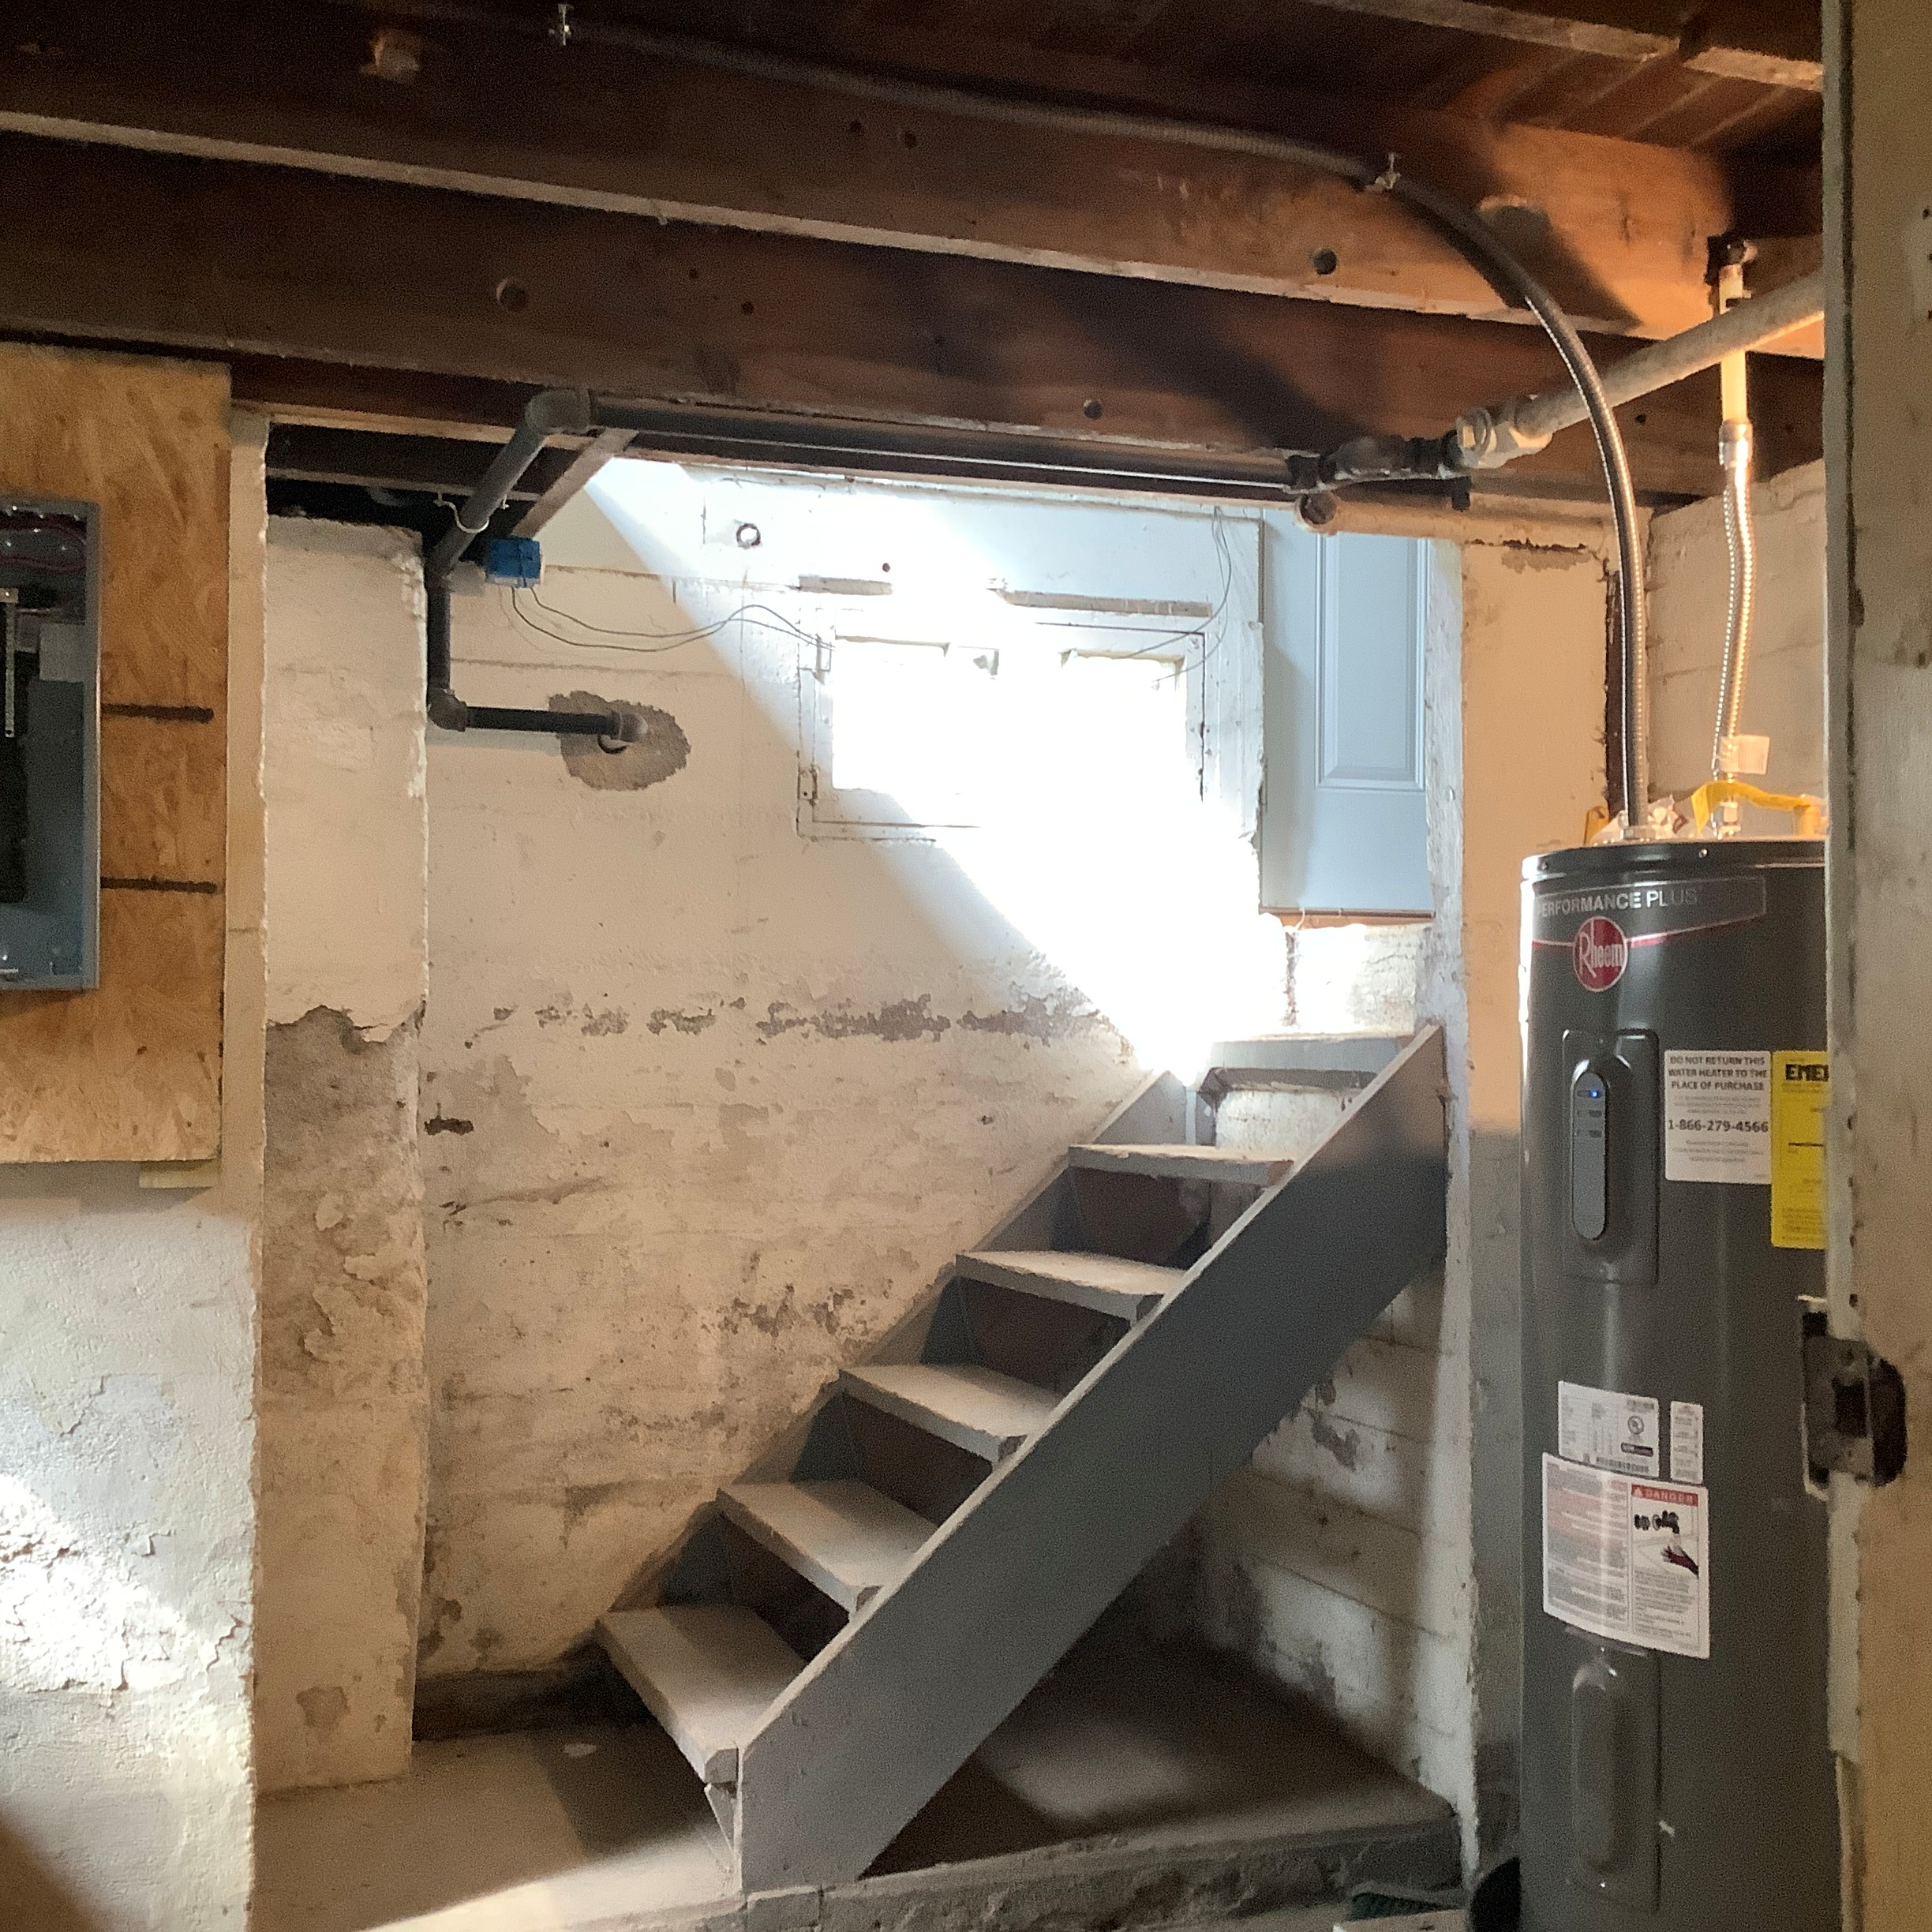

Slide 23
Section R320.5 – Handrail Termination
A handrail end shall be returned continuous to itself or toward a wall, guard or walking surface. Handrail returns shall not form a gap more than 1/4 inch (6.4 mm) from the adjacent wall.
The ¼” gap is new. Locally we pretty much allowed this as a judgement call in the field, but now it’s codified.

Slide 24
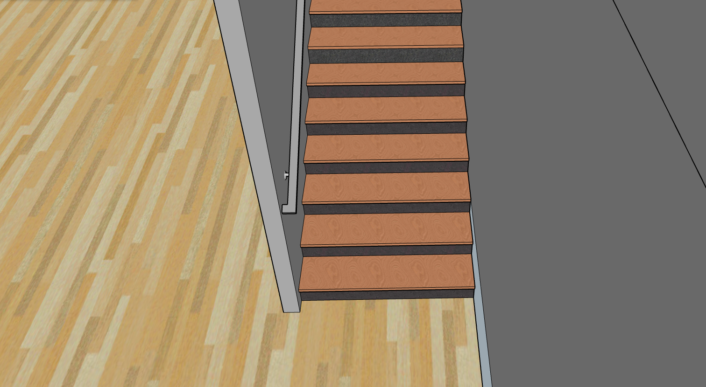

Slide 25
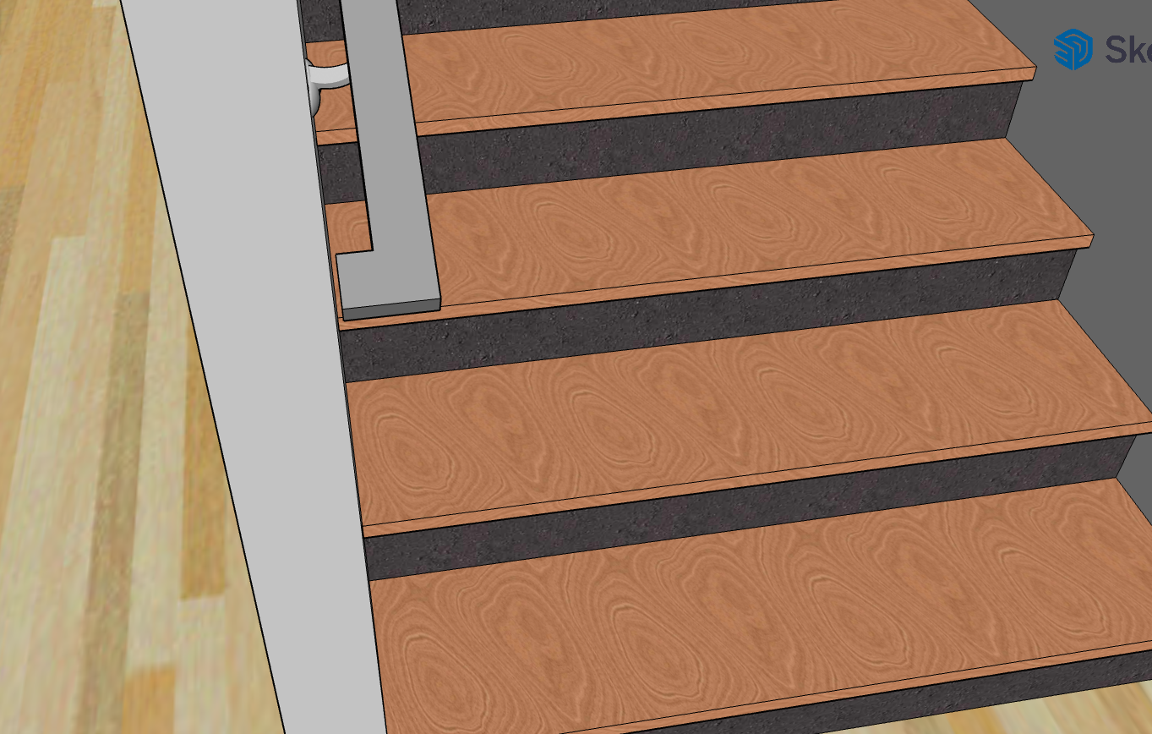

Slide 26
Section 329.6.4 – BIPV Hazards
When Building Integrated Photovoltaic Systems are installed in a manner that conceals electrical hazards from view, markings shall be provided to avoid ladder placement in that area.
Markings shall be reflective and visible from grade. BIPV systems listed to UL3741 (such as Tesla roofs), do not require these markings.
Notes:
For firefighters, primarily. UL3741 is testing criteria that basically proves that firefighters can cut out and remove sections of the BIPV system without encountering a shock hazard, so they are unlikely to be damaged by a ladder. Code testimony stated that most BIPV systems are rated to UL3741. This does not apply to regular panels that are obviously solar panels when you see them, it’s for systems that blend in and are not obvious.

Slide 27
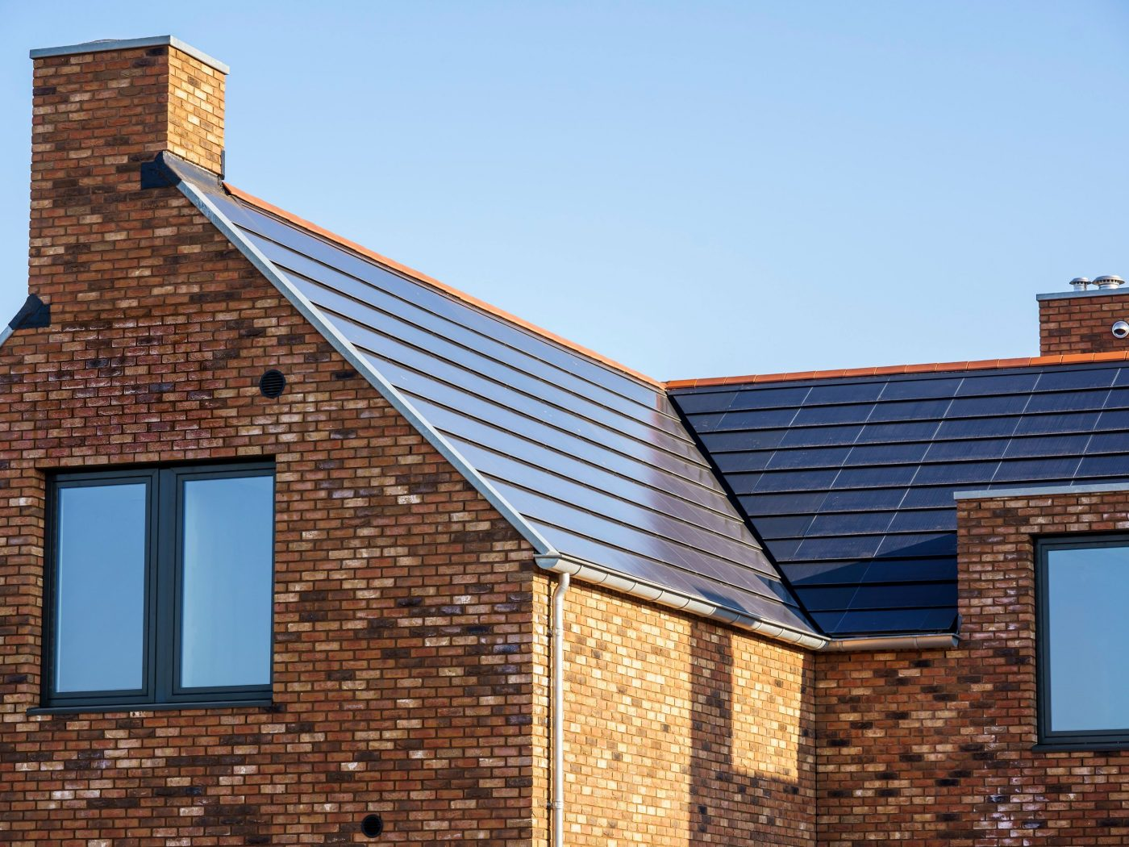
Photo of BIPV from https://www.wienerberger.com/en.html on 10-22-2025

Slide 28
Section 329.7.1 – Solar Panel Fire Rating
When PV panels are installed on a non-combustible or open frame elevated support structure, they must be listed and labeled with a fire type rating in accordance with UL 1703 or with both UL 61730-1 and UL 61730-2.
Panels installed above roof assemblies on an elevated support structure shall be identified with a fire classification in accordance with UL 2703.
Notes:
Roof assemblies have to meet a Class A, B, or C rating, but the tests to evaluate that are not compatible with some solar panels. For that reason, guidance is given as to what fire rating/testing is required for each type of roof construction. An “elevated support structure” is not defined, but is intended to mean a carport or a solar rack that is tall enough to walk under. The “elevated support structure” is not intended to be a roof for the purposes of evaluating the number of stories, but obviously creates some similar fire hazards.

Slide 29
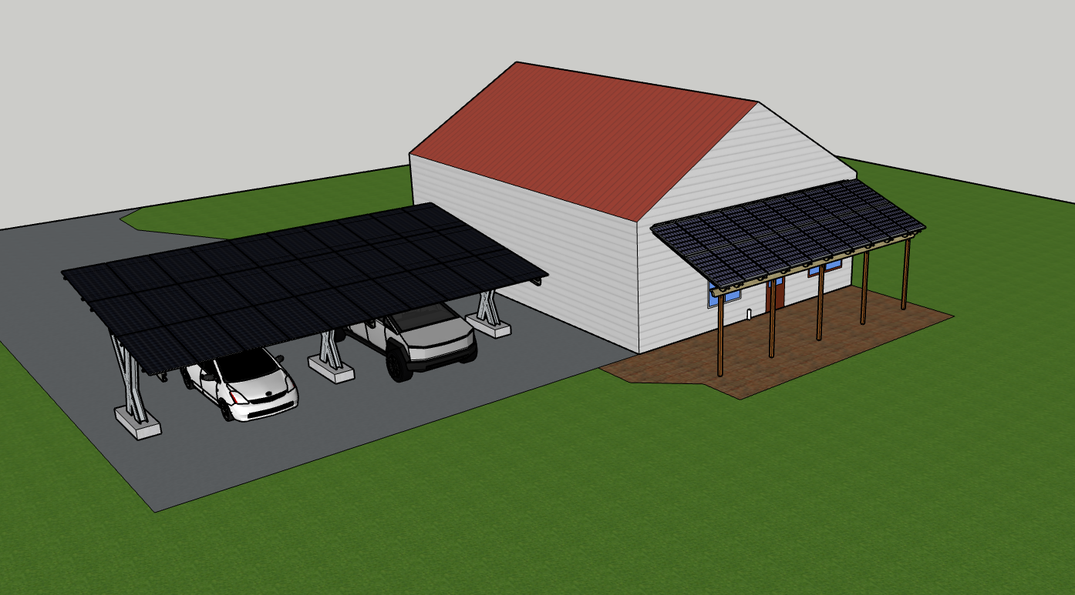
Notes:
Roof assemblies have to meet a Class A, B, or C rating, but the tests to evaluate that are not compatible with some solar panels. For that reason, guidance is given as to what fire rating/testing is required for each type of roof construction. An “elevated support structure” is not defined, but is intended to mean a carport or a solar rack that is tall enough to walk under. The “elevated support structure” is not intended to be a roof for the purposes of evaluating the number of stories, but obviously creates some similar fire hazards. Both the pergola attached to the house and the non-combustible detached “carport” need to comply with this section.

Slide 30
Section 330.4 – Energy Storage Systems
ESS installed in enclosed utility closets, basements, storage or utility spaces within dwelling units must have minimum 5/8” gypsum on the walls and ceilings. (2021 IRC)
Any opening into the dwelling shall be equipped with a self-closing solid wood door, solid or honeycomb-core steel door, or a door with a 20-minute fire protection rating. (2024 IRC)
Notes:
No reason to rate the walls and not rate the door. Lithium Energy Storage Systems like the Tesla Powerwall burn at approximately 2,000 degrees Fahrenheit, and rooms normally flash over around 1,000 degrees.

Slide 31
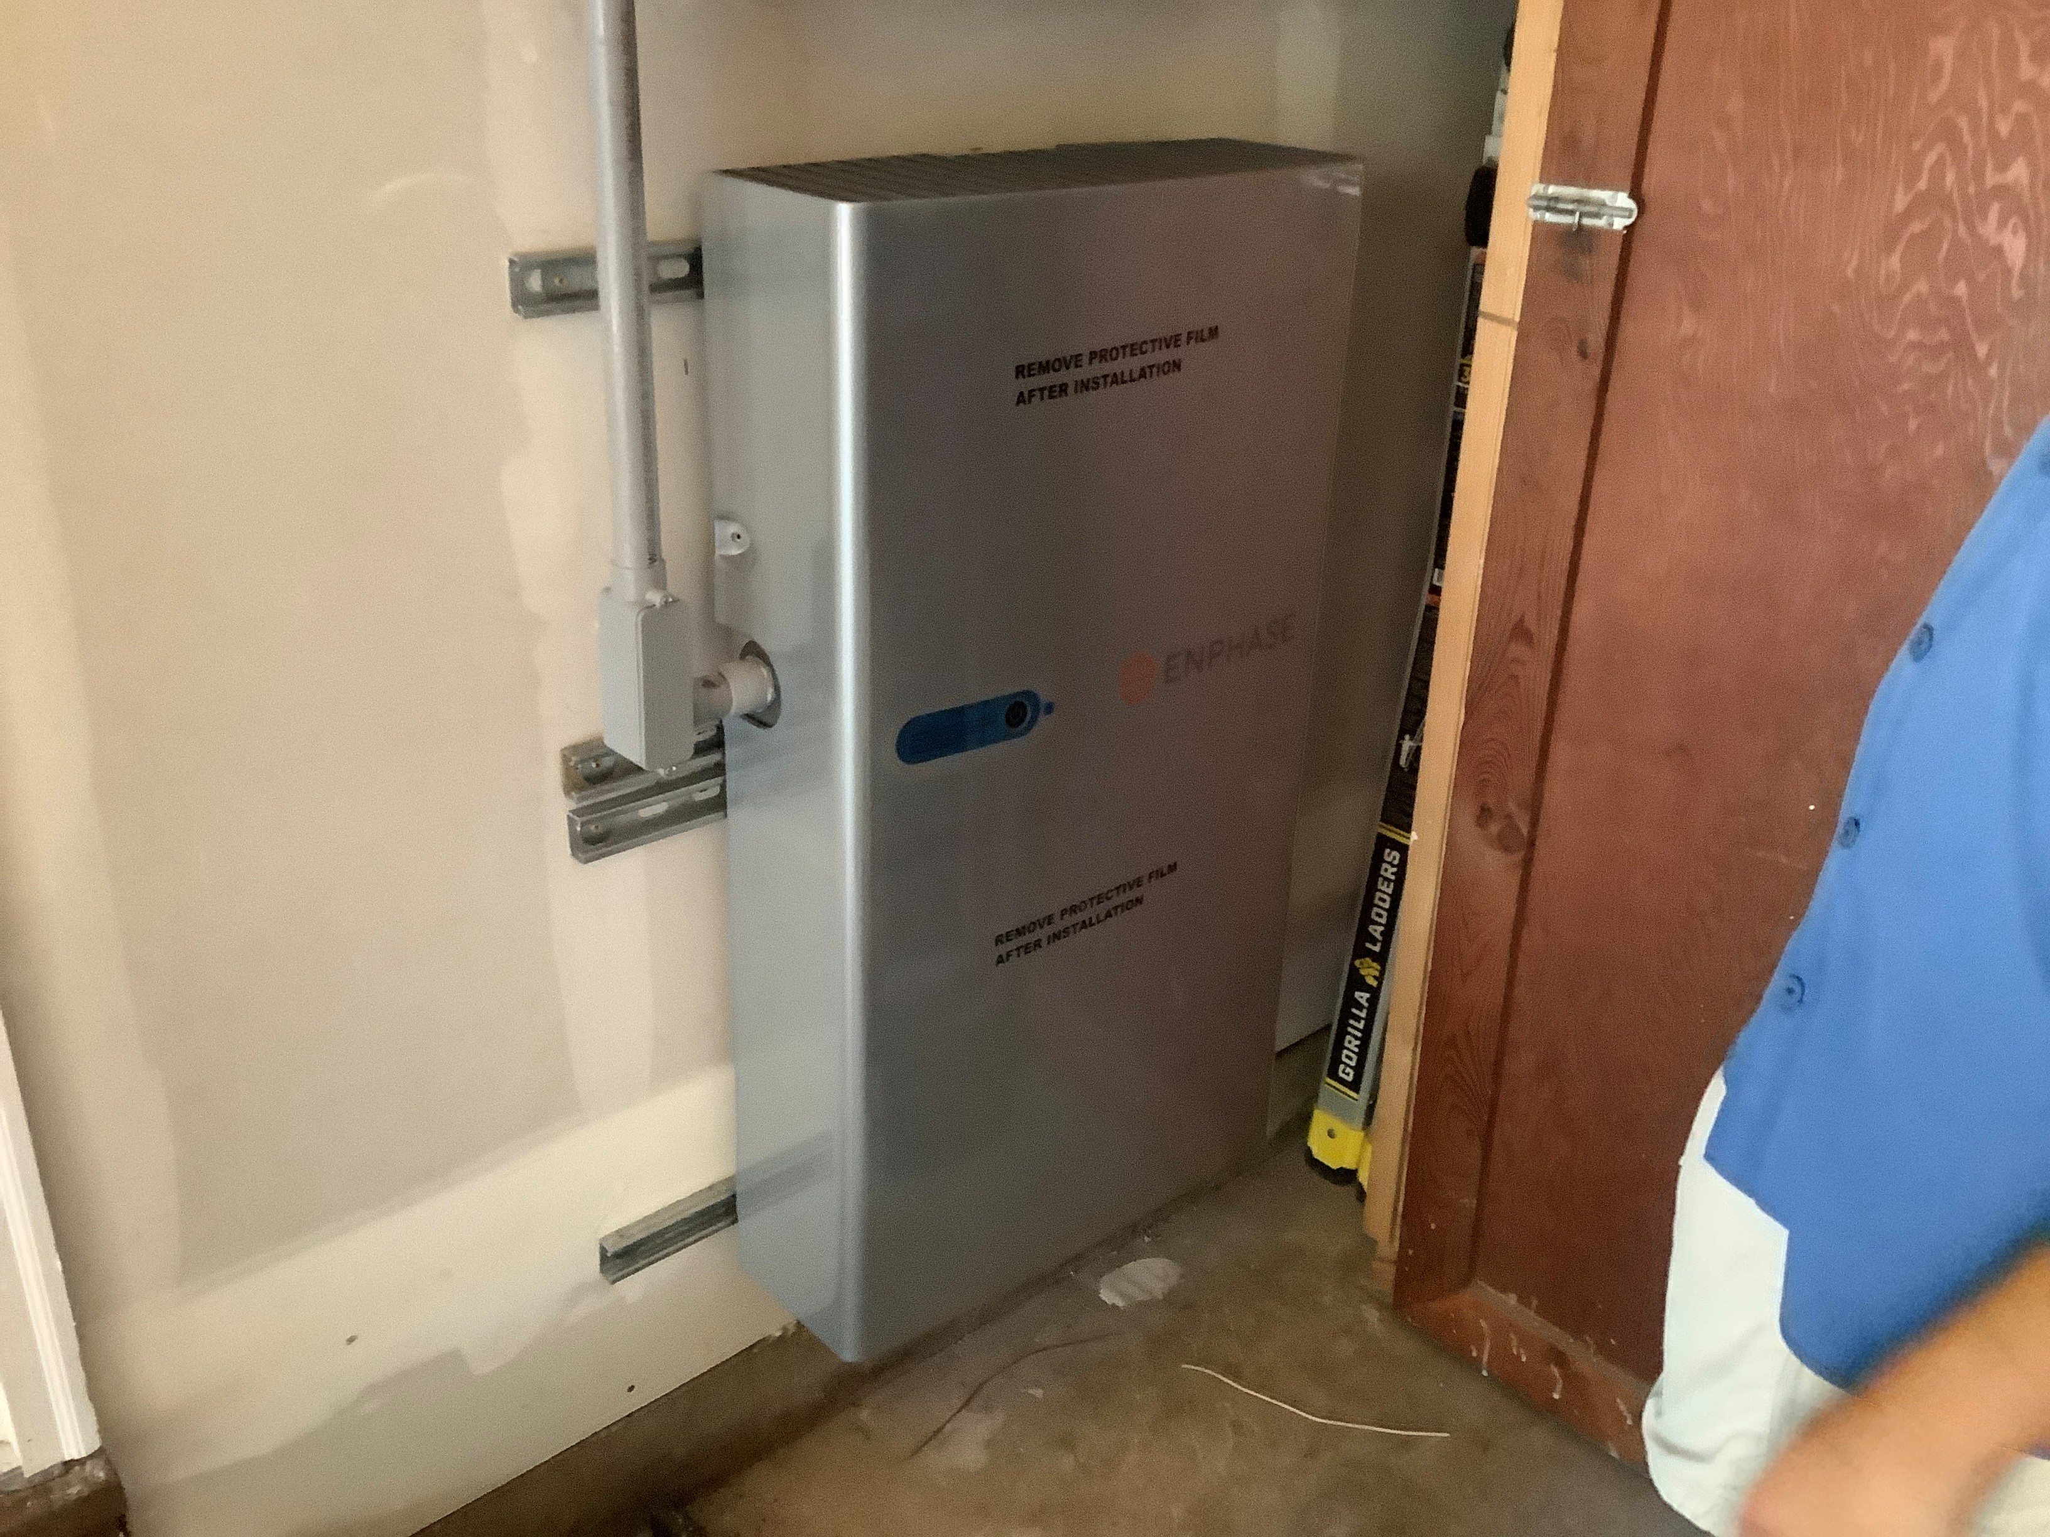

Slide 32
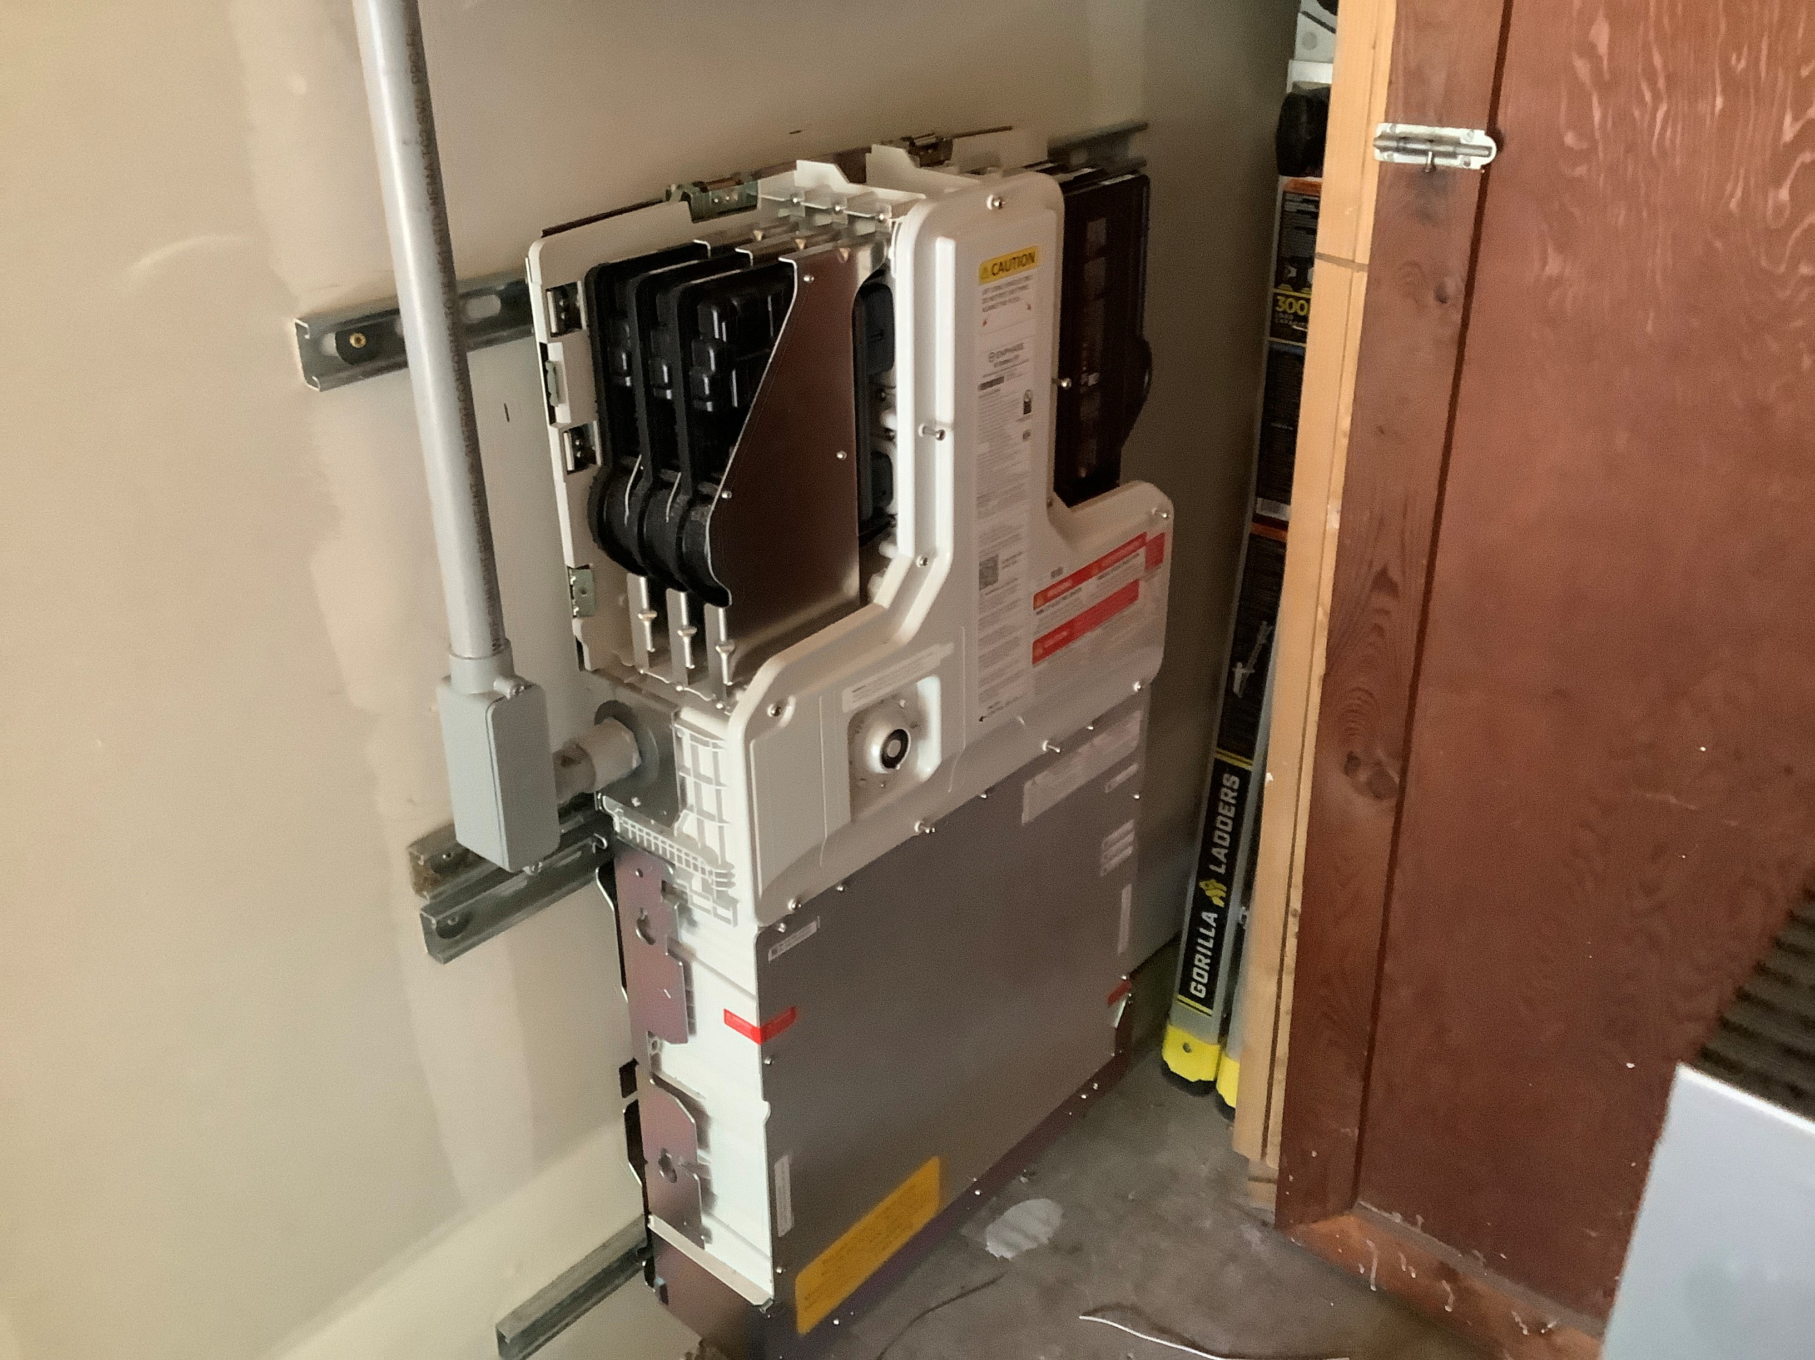

Slide 33
Section 330. – ESS Vehicle Impact
Where an ESS is installed in the normal driving path of vehicle travel within a garage, impact protection complying with Section R330.8.3 shall be provided.
The normal driving path is a space between the garage vehicle opening and the interior face of the back wall to a height of 48” above the finished floor. The width of the normal driving path shall be equal to the width of the garage door opening.

Slide 34
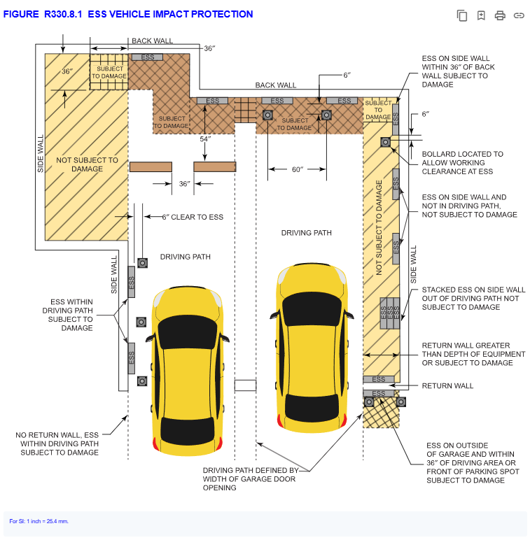
2024 IRC

Slide 35
Section 330. – ESS Vehicle Impact Pt. 2
Compliant ESS impact protection:
(1) Schedule 80 steel bollards filled with concrete, not less than 36” in height, 3” in diameter, placed at least 6” from the ESS, securely anchored, and not more than 60” apart.
(2) Wheel barrier curbs not less than 4” in height, placed at least 54” away from the ESS, securely anchored, and not more than 36” apart.
(3) An approved method engineered to resist 2000 psf impact 24” above grade.
Notes:
Steel bollards - Schedule 80 steel pipe embedded in a concrete pier not less than 12 inches (305 mm) deep and 6 inches or Schedule 80 steel pipe fully welded to a steel plate not less than 8 inches (203 mm) in length by 1/4 inch (6.4 mm) in thickness and bolted to a concrete floor by means of 4 1/2-inch (114 mm) concrete anchors imbedded not less than 3 inches (76 mm)52 mm) in diameter, or premanufactured steel pipe bollards filled with concrete and anchored in accordance with the manufacturer’s installation instructions. Bollards shall not encroach on working space.

Slide 36
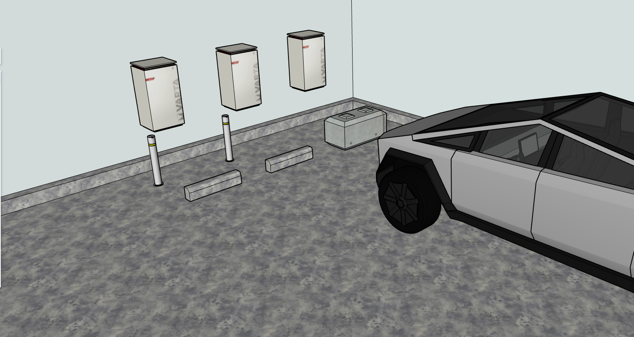
Notes:
Showing the steel bollards, the concrete curbs 54” away, and “other approved means that can withstand 2000 PSF” – like a giant concrete block, or a limestone retaining wall chunk.

Slide 37
Section 403.5 – Crushed Stone Footings
Crushed stone footings in accordance with Section R403.4.1 shall be permitted for nonretaining cast-in-place concrete foundations complying with Section R404.1.3 and this section. (Trench footings.)
Basically, you trench per normal, then you place clean gravel (1/16” – 1/2”), compacted in 8” lifts, from frost depth to the point at least 4” below grade, then normal concrete foundation above that.
Notes:
The theory is that the compacted gravel can’t heave because it is so drainable it won’t have enough moisture high enough to freeze and heave, and there are spaces for the expansion to occur between the rocks so that it does not lift the foundation. Had to be engineered before, now prescriptive. Needs special inspection of compaction of gravel.

Slide 38
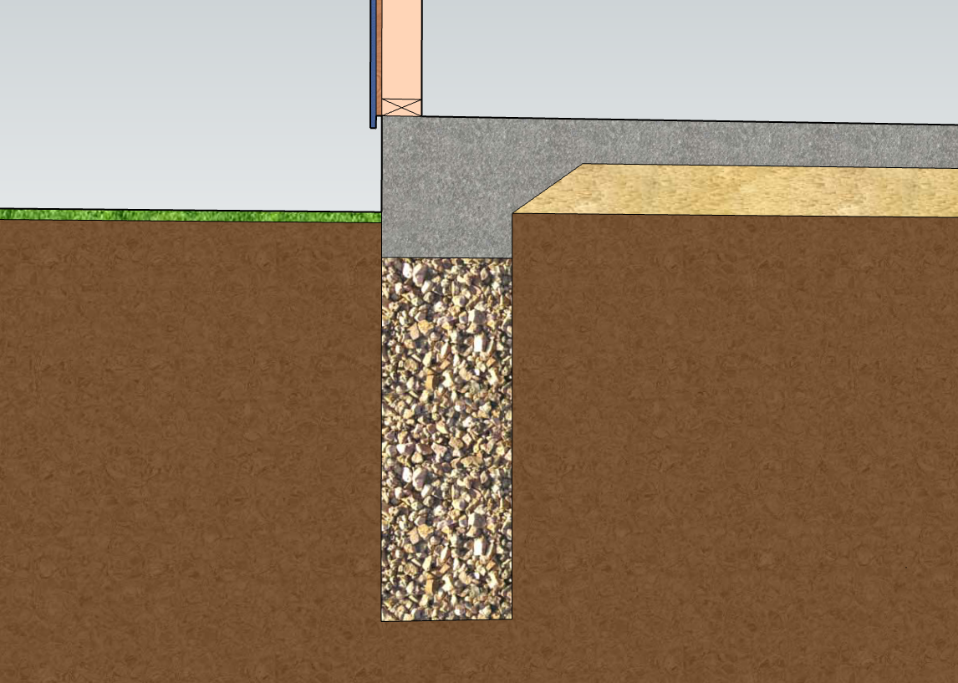
Wood and siding min. 6” above grade
Min. 4” below grade
Needs Special Inspection for Compaction
Clean gravel (1/16 - 1/2”), compacted in 8” lifts
Frost depth 34” min.
2024 IRC
Notes:
Somebody has to verify that the proper size of gravel was compacted in in 8” lifts, therefore the special inspection will be required.

Slide 39
Section 406.3.3 – Vapor Retarders
The plastic vapor retarder placed under concrete slabs is allowed to be 6 mil plastic instead of 10 mil plastic.
They changed to require 10 mil in the 2021 code, changing back in the 2024 to the way it has always been at 6 mil. 2024 language is now identical to the 2018 IRC.

Slide 40
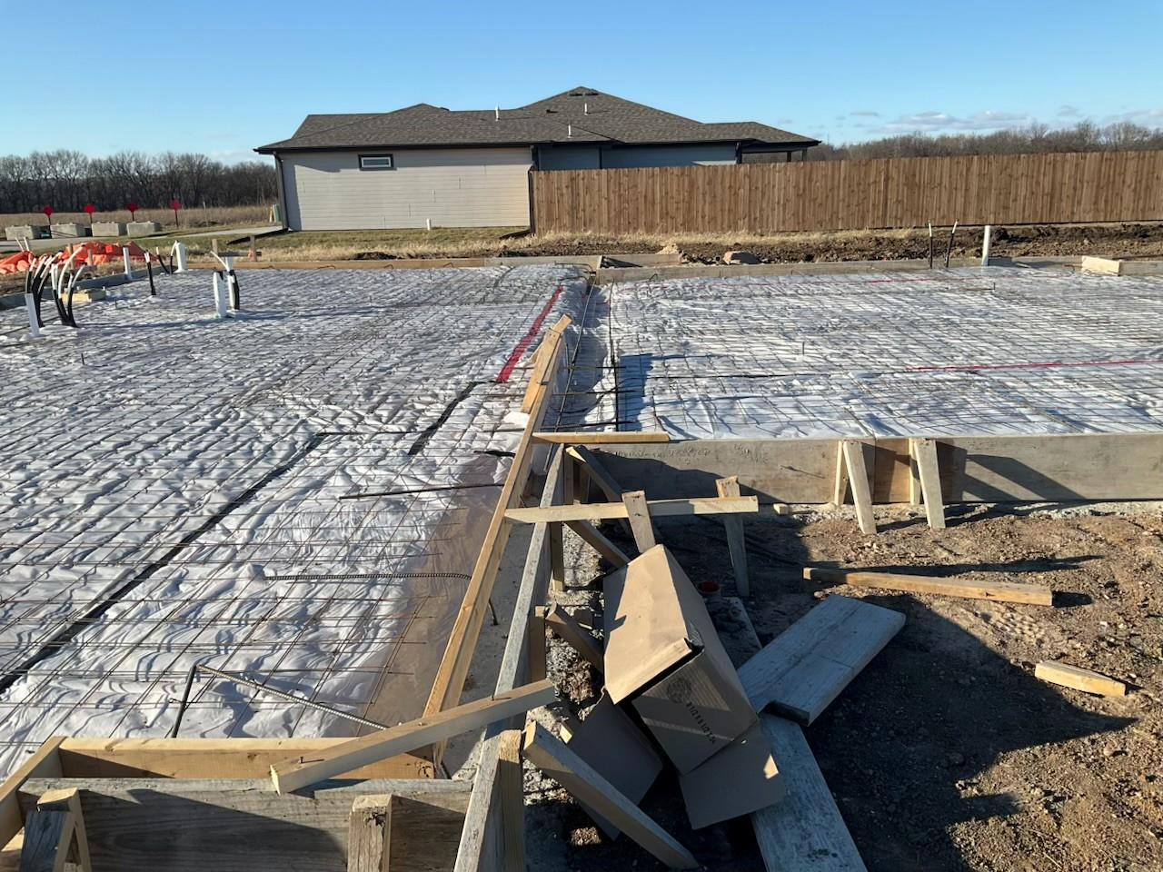

Slide 41
Section 507.5(1) – Deck Beams
Deck beam tables in the IRC have been reworked, and beam spans have changed. Throw out the old tables!
Software can also be used to size beams and joists, and there is free software available that can size sawn lumber, LVLs, and glu-lams.

Slide 42
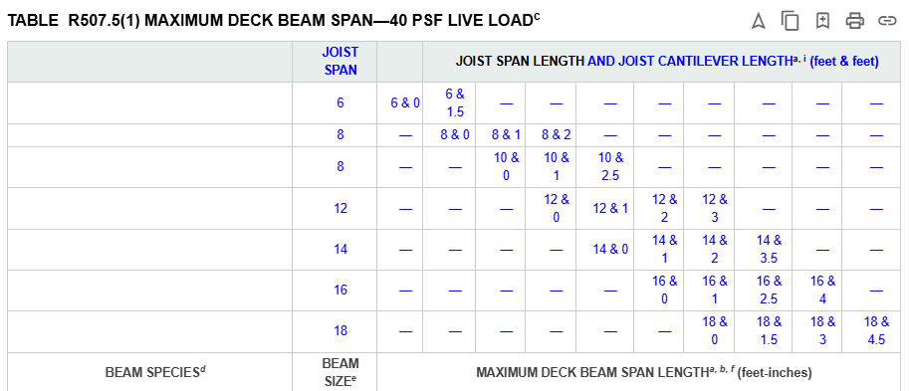
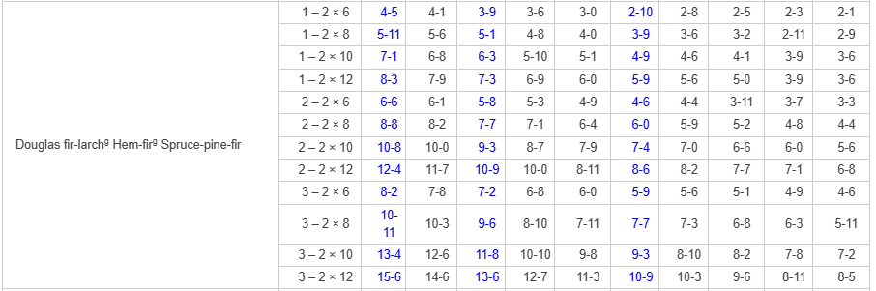

Slide 43
Section 507.9.1.5 – Ledger Flashing
Specific flashing requirements have been added for deck ledgers. The WRB of the house shall be lapped at least 2” over the vertical leg of the flashing, and continue down behind the ledger.
On existing houses that don’t have a WRB, a WRB shall be added behind the ledger, and the ledger flashing shall be taped to the sheathing with minimum 4” flashing tape. Or just use spacer pucks.

Slide 44
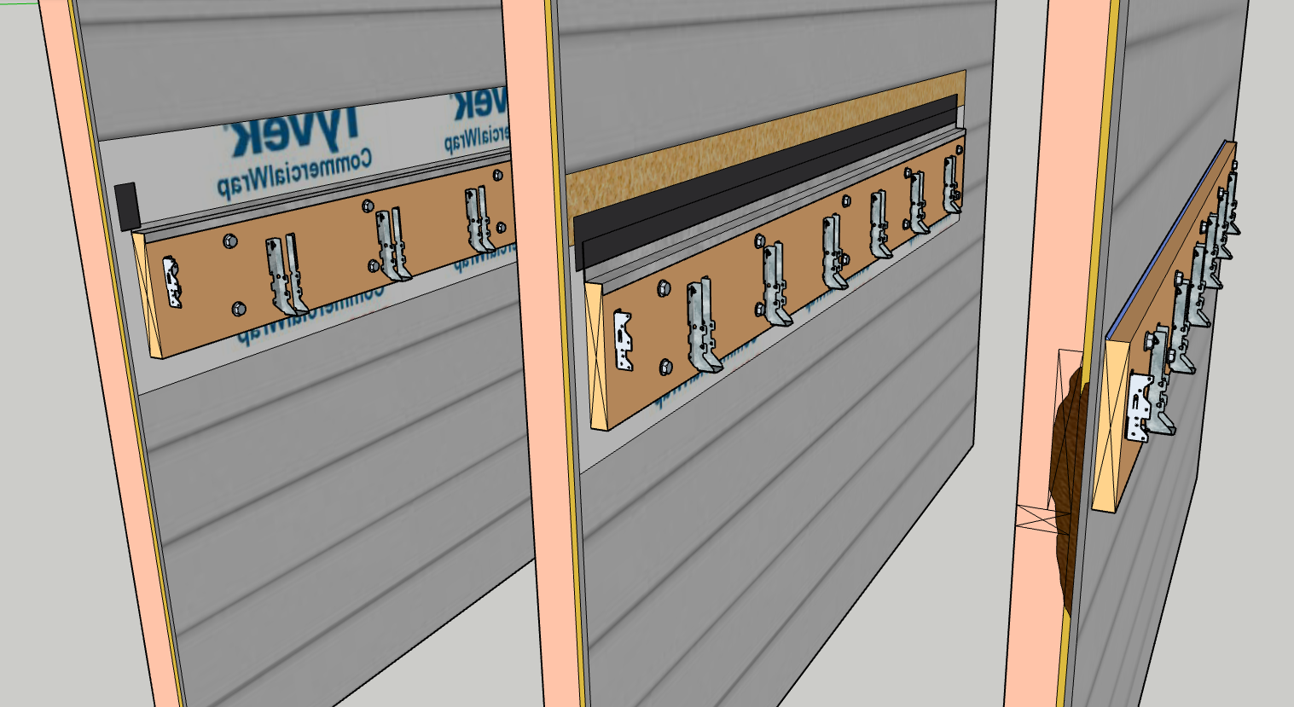

Slide 45
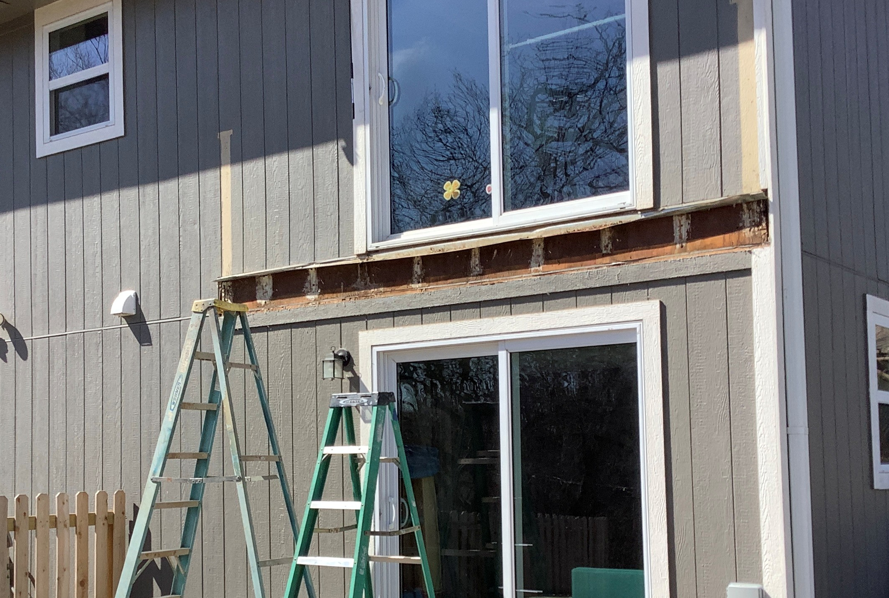

Slide 46
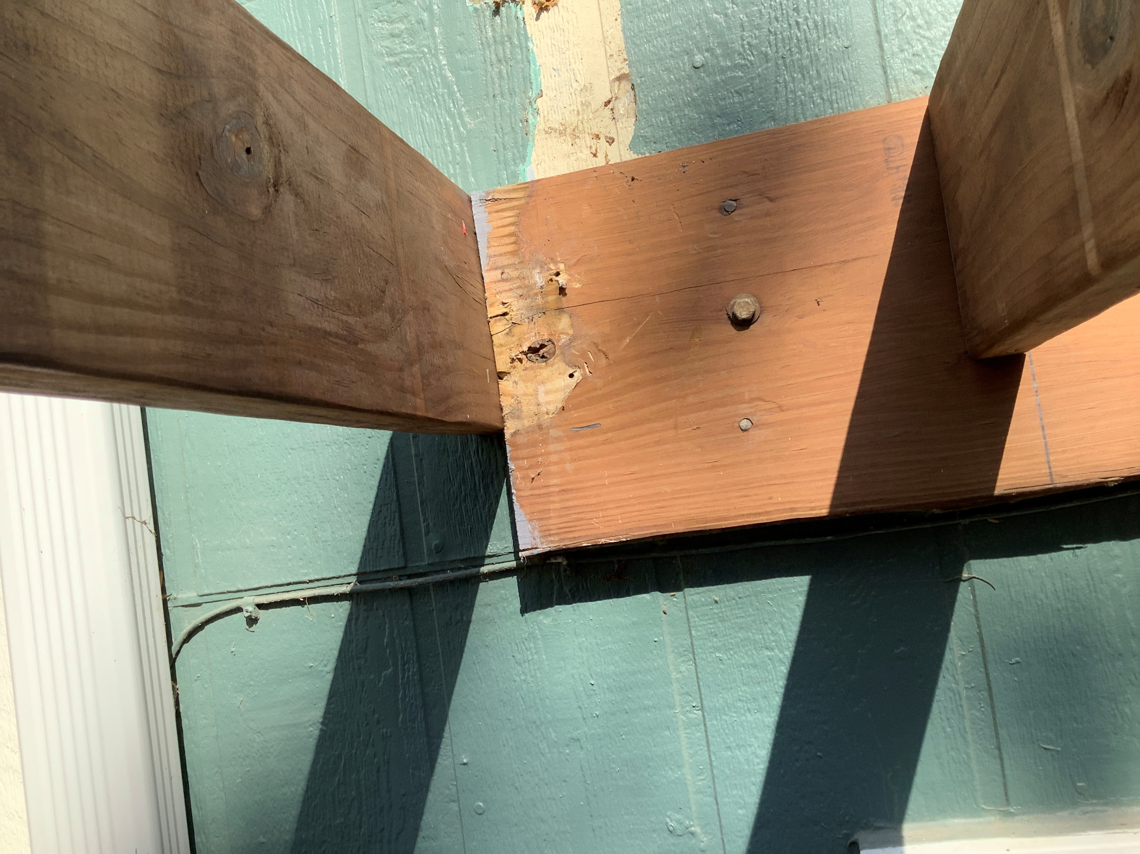

Slide 47
Section 703.11 – Vinyl Siding
Vinyl siding requirements added to address items that have been failure points in high wind events.
(1) Use the correct starter strip, not just a J channel.
(2) Keep it at least 6” above the dirt, ½” above concrete or roofs.
(3) Use proper trims, fastened properly, around windows/doors.

Slide 48
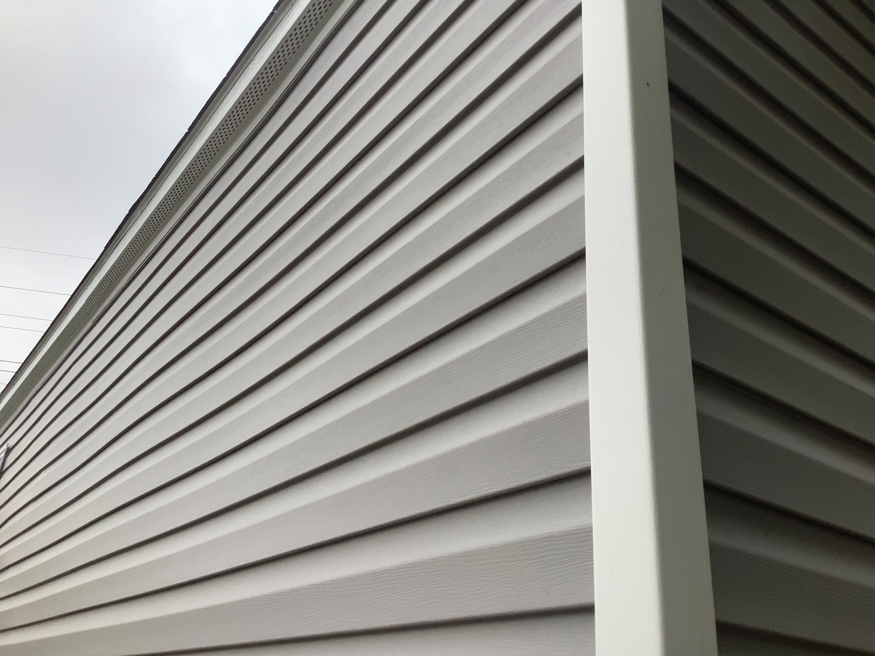

Slide 49
Section 703.14 – polypropylene siding
Polypropylene siding requirements added to address items that have been failure points in high wind events.
(1) Use the correct starter strip, not just a J channel.
(2) Keep it at least 6” above the dirt, ½” above concrete or roofs.
(3) Use proper trims, fastened properly, around windows/doors, not random J channels.

Slide 50
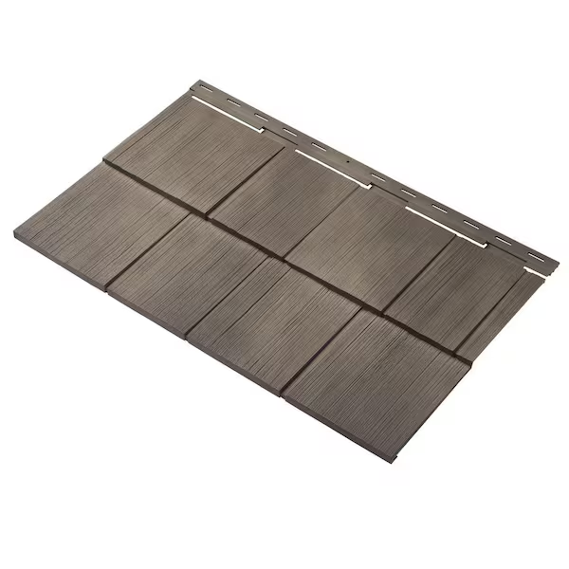
From https://www.homedepot.com/p/Ply-Gem-Cedar-Dimensions-Shingle-24-in-Polypropylene-Siding-Sample-in-Shaded-Cedar-CEDAR7SAMPLE-489/204723902 on October 27th, 2025

Slide 51
Section 704.4.1.1 – Aluminum Fascia
Aluminum fascia shall be nailed with at least one nail in the return leg every 24 inches, and the fascia shall be inserted at least 1” under the drip edge on the other side.
Where the fascia cannot be inserted under the drip edge, nail that side at 24 inches on center too.

Slide 52
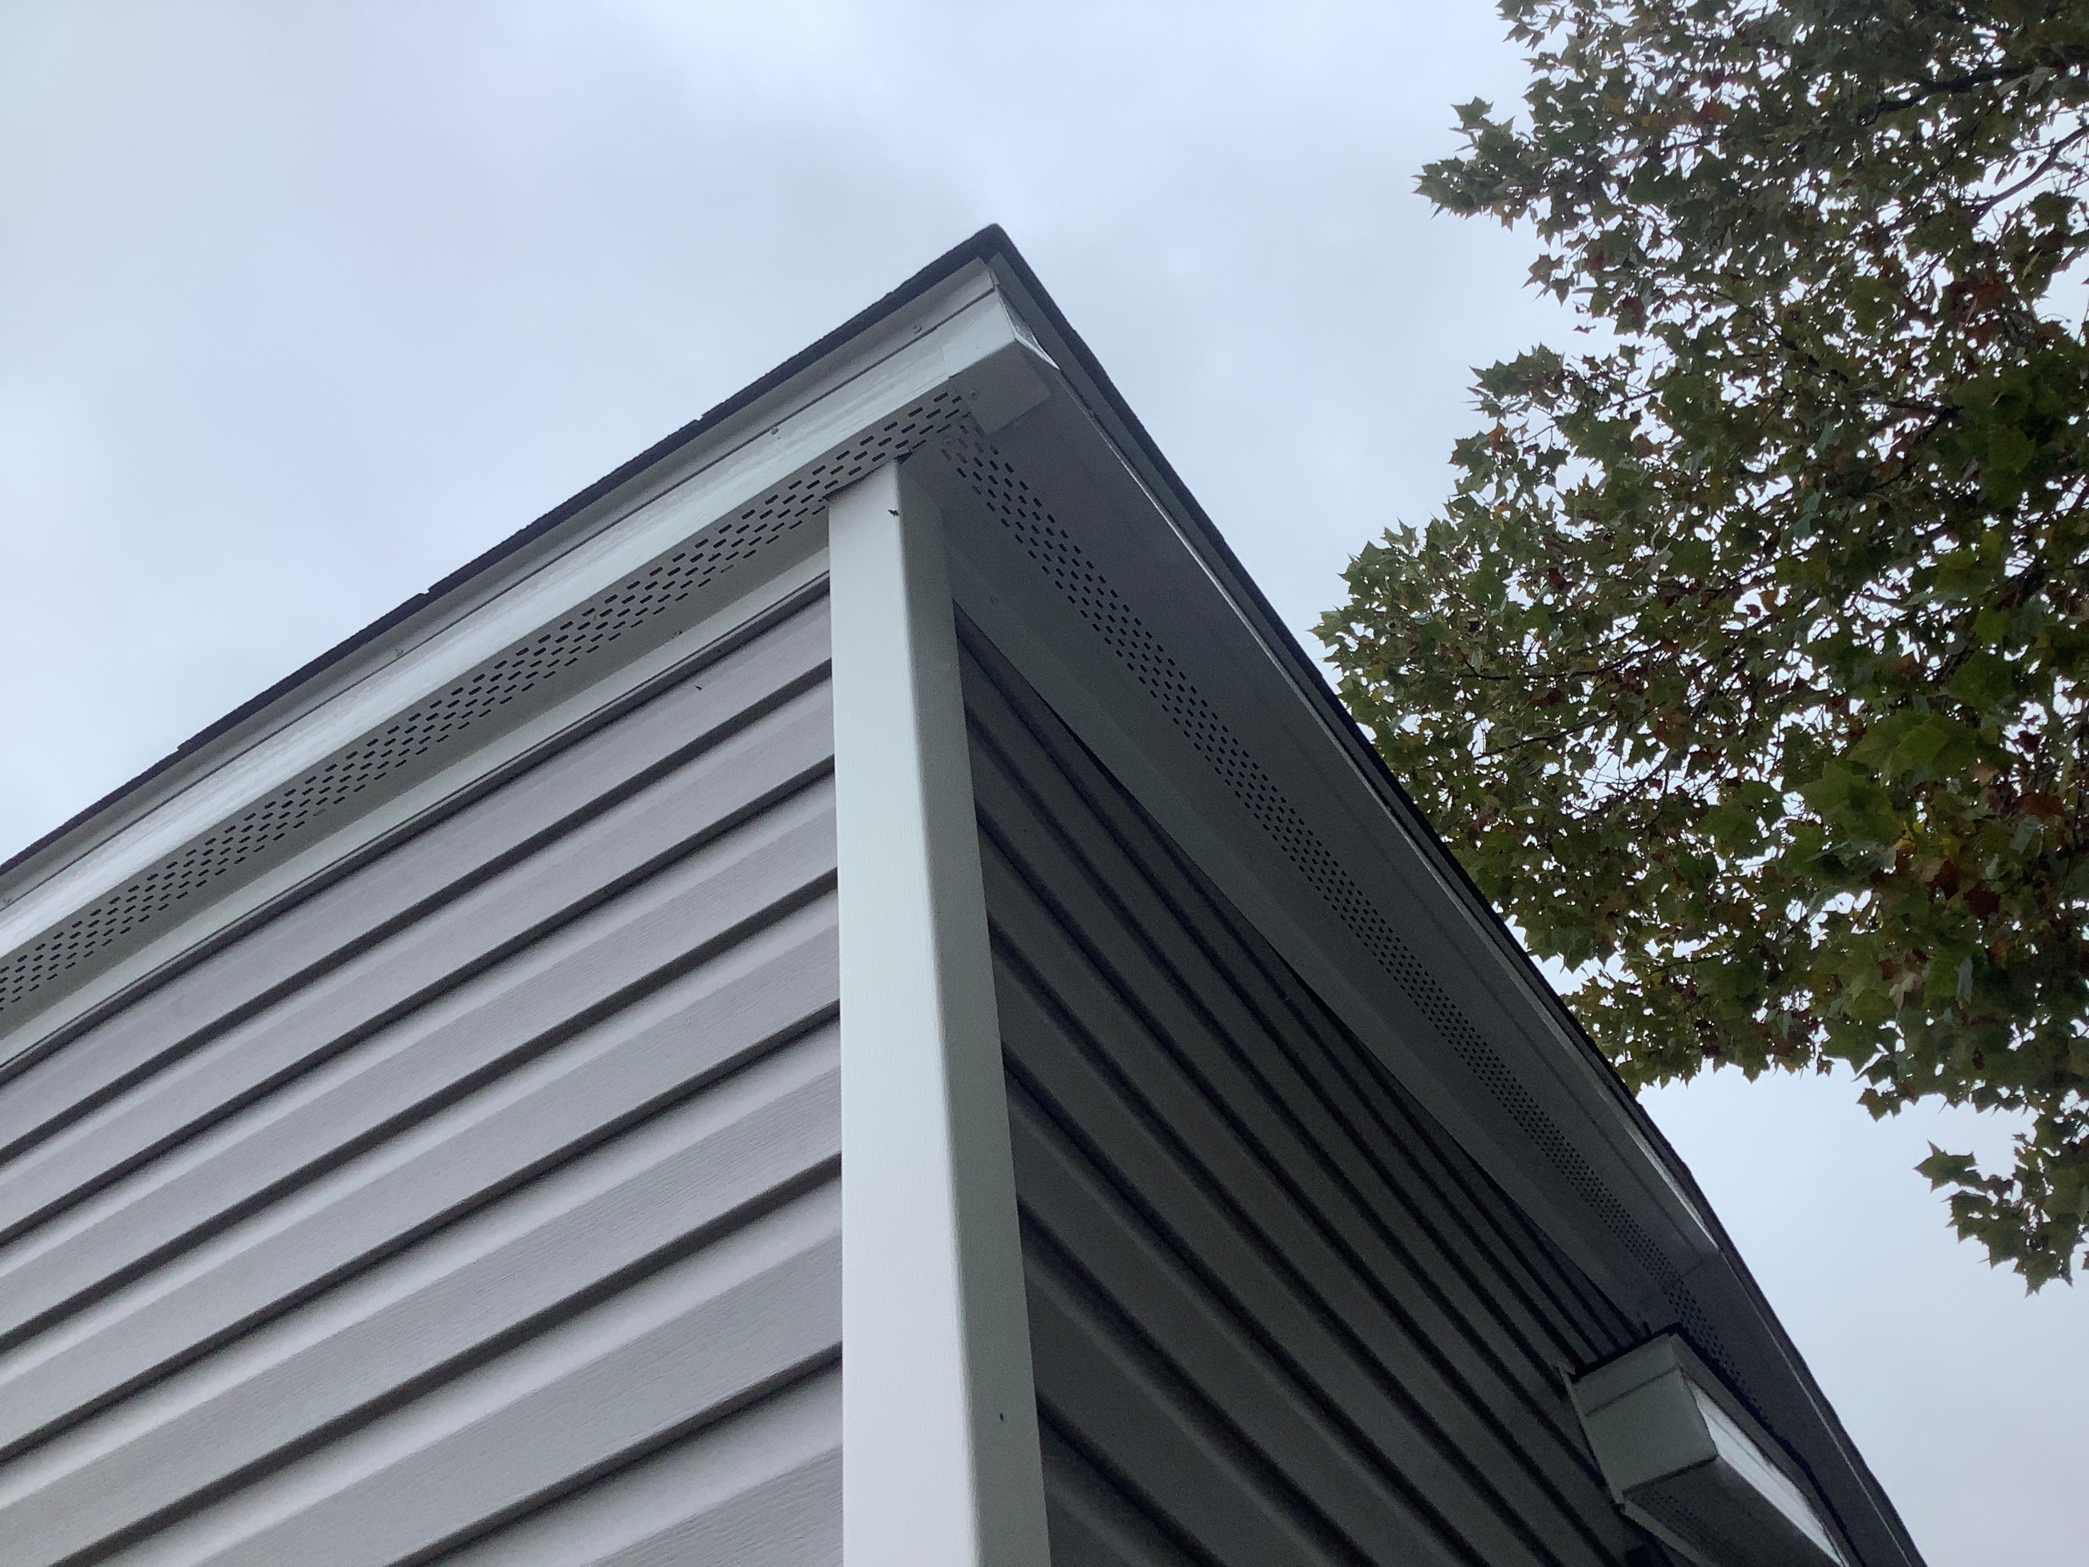

Slide 53
Section 908.3 – Roof Replacement
New exceptions added to the roof replacement section to allow an old peel-and-stick layer to remain if it is in good condition.
You just need to make sure the new underlayment you put on over the old one is compatible with the old one.

Slide 54
Section 1001.11 – Fireplace Clearances
Now permitted to fill the required airspace around an insert fireplace or firebox with a non-combustible material.
Non-combustible materials are those materials that can pass ASTM E136, such as unfaced fiberglass insulation or mineral wool.

Slide 55
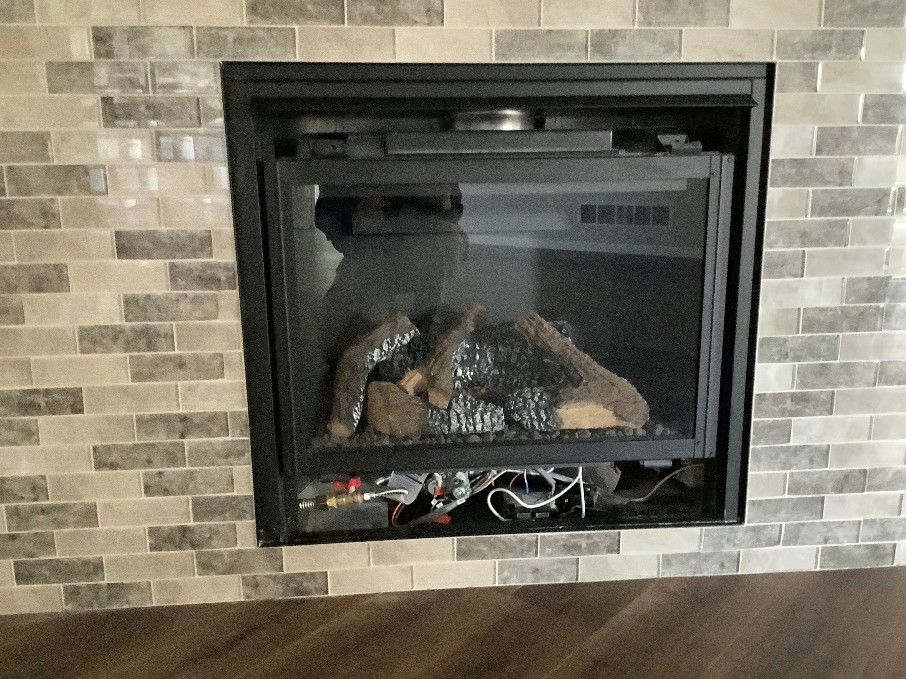

Slide 56
All MEP’s – Nail Plate distance
Nail plates shall be installed whenever any duct, pipe, cable, or any other MEP is within 1 ¼” of the nailing face of a framing member.
2024 IRC finally coordinated all MEPs to have the same dimension for protection from fasteners – before some had a 1 ½” clearance, and some had a 1 ¼” clearance.

Slide 57

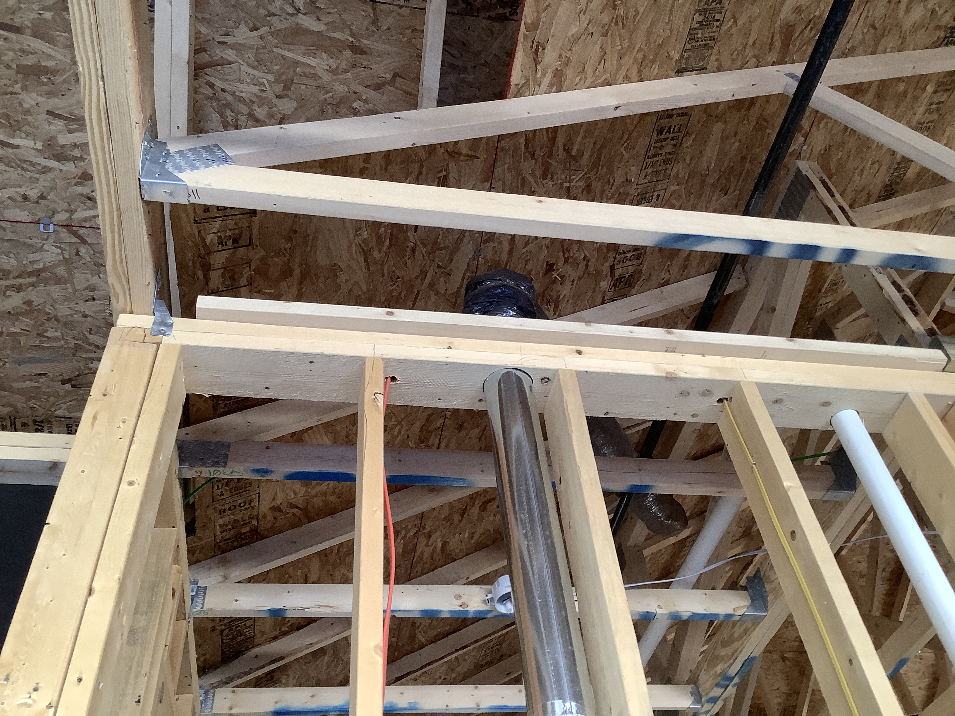

Slide 58
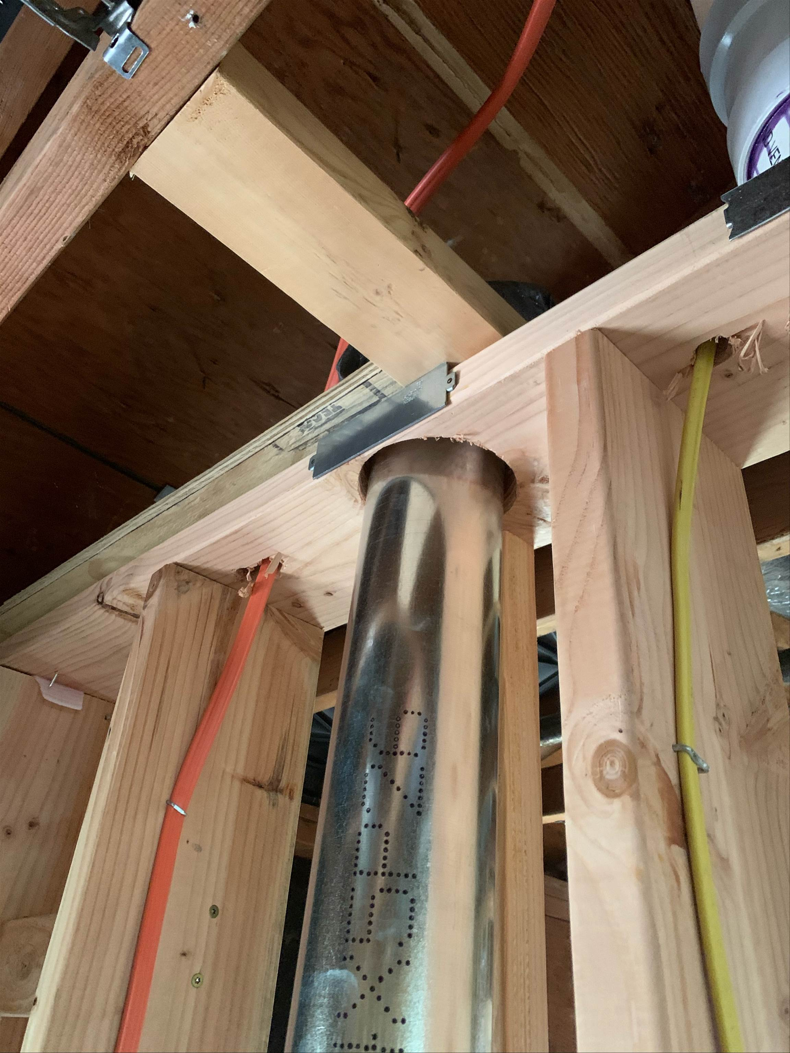

Slide 59
Section 1411.5 – A2L Labels
Each refrigeration system using Group A2L refrigerant shall have the following indicated on a markable label provided by manufacturer: (1) Installer contact info (company, not individual). (2) The system refrigerant charge and the refrigerant number.
Notes:
EPA requirement also. Not in IMC.

Slide 60
Section 1502.6.1 – Dryer Makeup Air
Dryers exhausting more than 200 CFM will need makeup air to be provided. All dryers installed in a “closet” will also need makeup air, sized per dryer manufacturer, regardless of CFM.
Makeup air can be provided through transfer openings or ducted from outdoors. If the dryer specs don’t specify makeup air, the code specifies 100 sq. in. of opening.

Slide 61
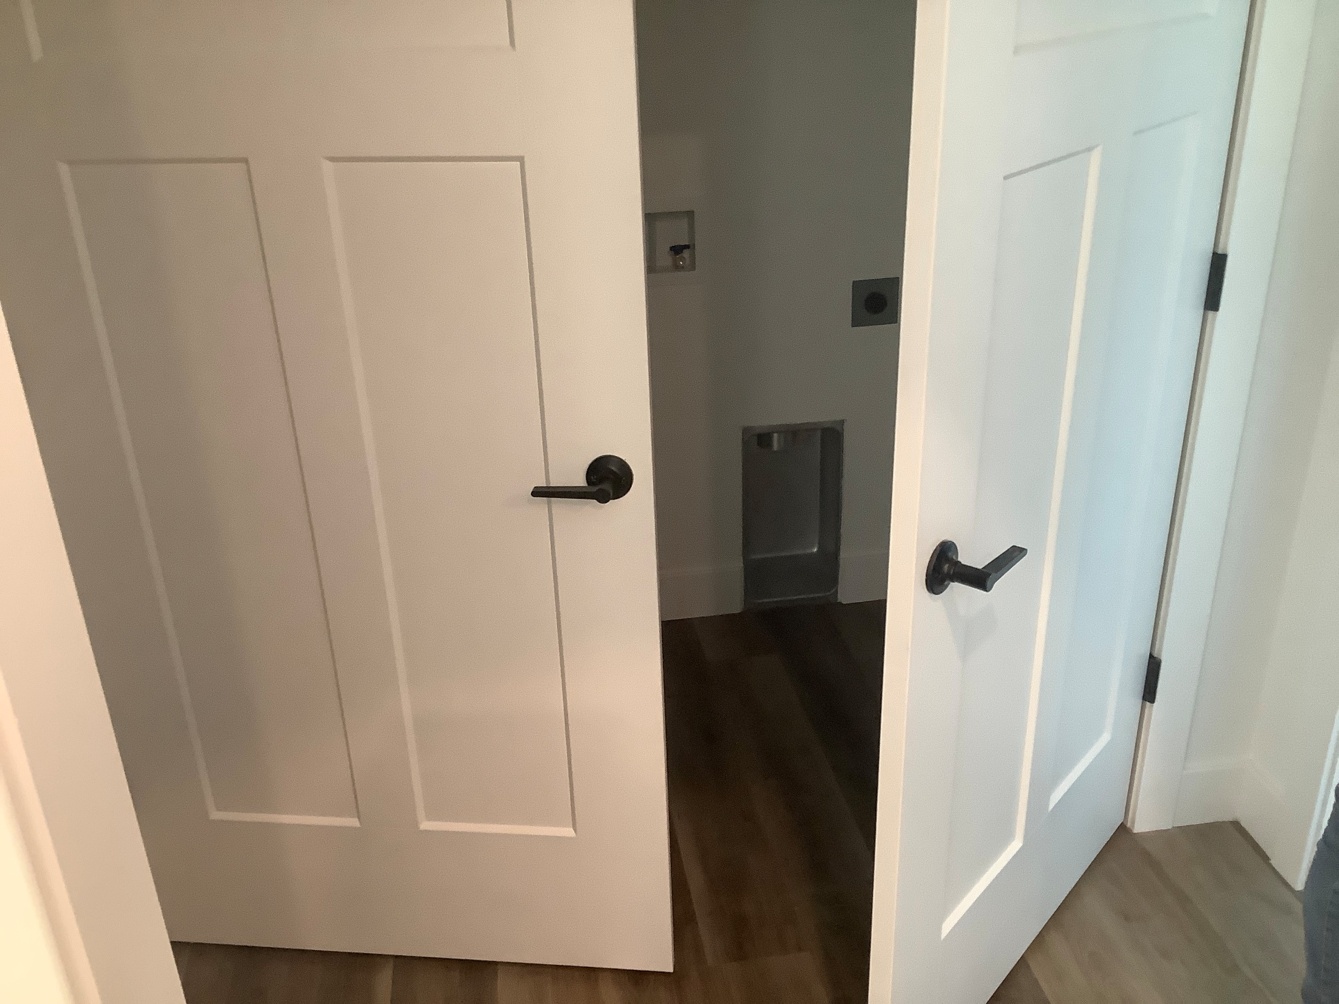

Slide 62
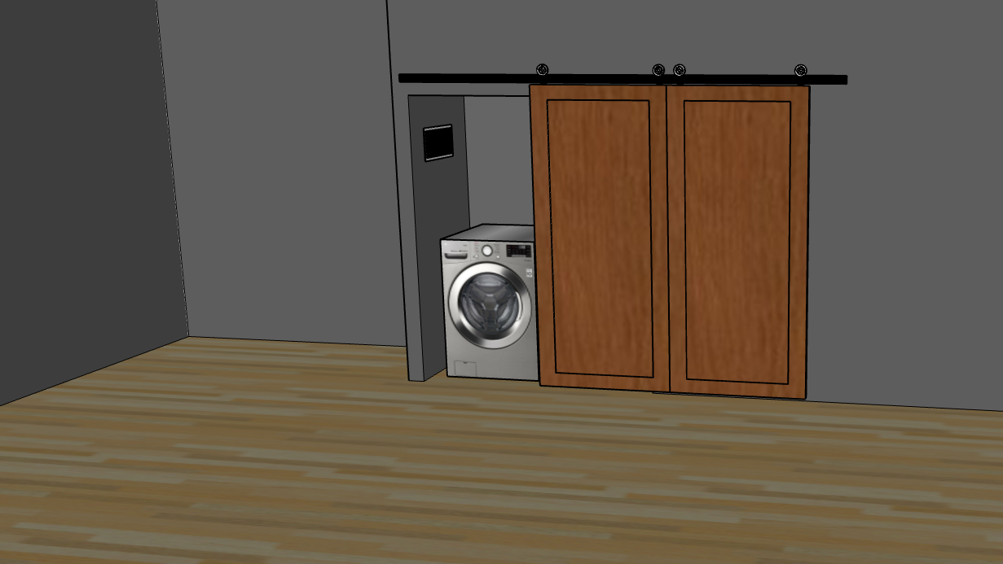

Slide 63
Section 1602.2 – return Air, Mech Room
You can now pull return air from mechanical rooms, if all appliances are sealed combustion and the return air only serves the mech room.
The mech room does not need supply air, but you must limit the pressure differential to 0.01 inch water column by undercutting the door or similar.
Notes:
They are starting to have more problems with mold and etc. in mech rooms and similar because houses are getting tighter and mechanical units are becoming more efficient.

Slide 64
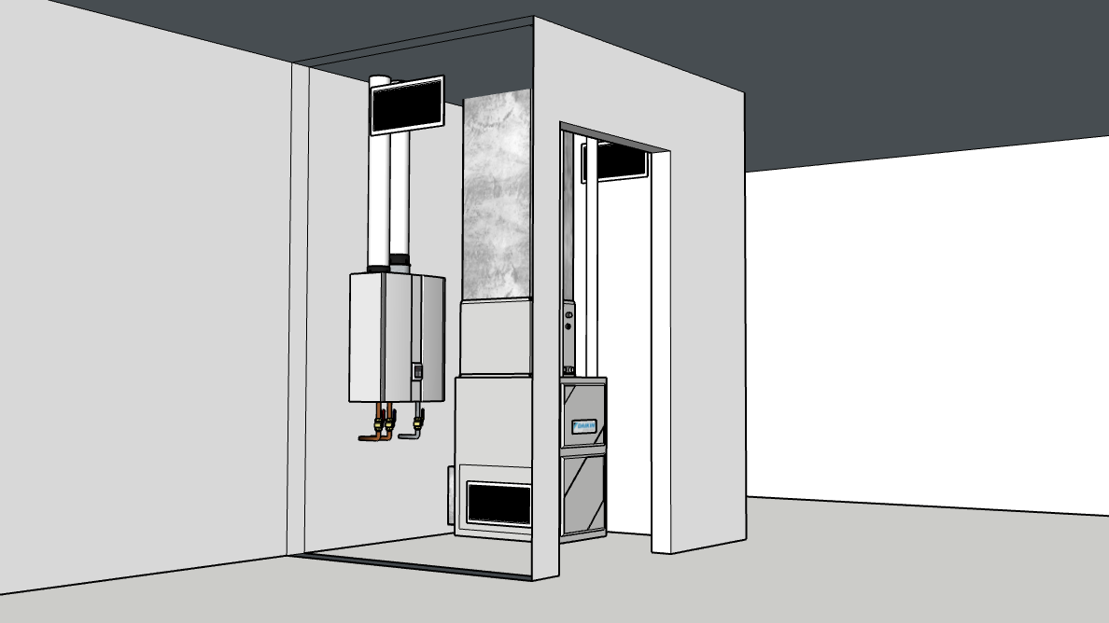
Notes:
Pulling in a little return air through the mech room to deal with a “musty smell”.

Slide 65
Section 1602.2 – return Air, Closet
You can now pull 30 CFM or less return air from closets to circulate air in the closet to prevent mold and moisture issues, without providing a supply duct. The return air only serves the closet.
The closet door shall be undercut at least 1 ½”, or have an opening with a net free area of not less than 30 square inches.
Notes:
They are starting to have more problems with mold and etc. in closets rooms and similar because houses are getting tighter and mechanical units are becoming more efficient.

Slide 66
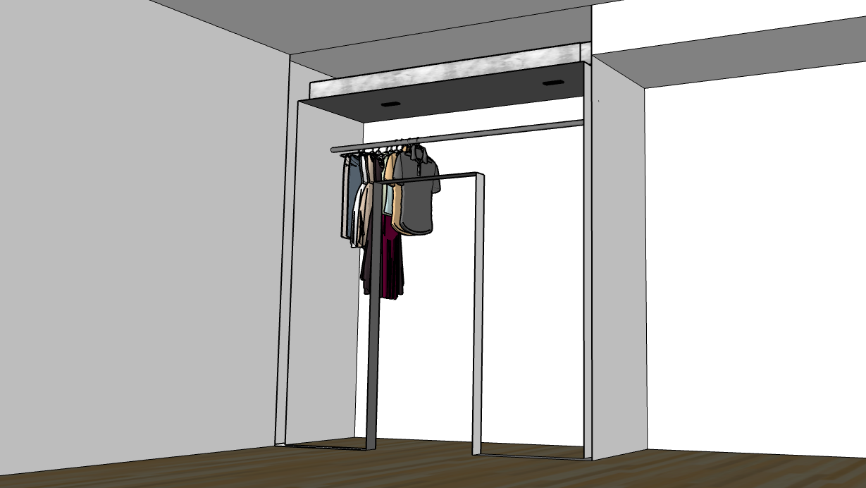
Notes:
Small return air openings in the ceiling, drawing through the closet from undercut door.

Slide 67
Section 2002.4 – Boiler Discharge
Added from IMC. Boiler discharge pipe requirements are like water heaters, but not the same. Boilers are allowed to discharge through an air break instead of an air gap, and can be black steel pipe.
You can’t use black steel pipe on a water heater or boiler connected to domestic water because the pipe is not rated for potable water.

Slide 68
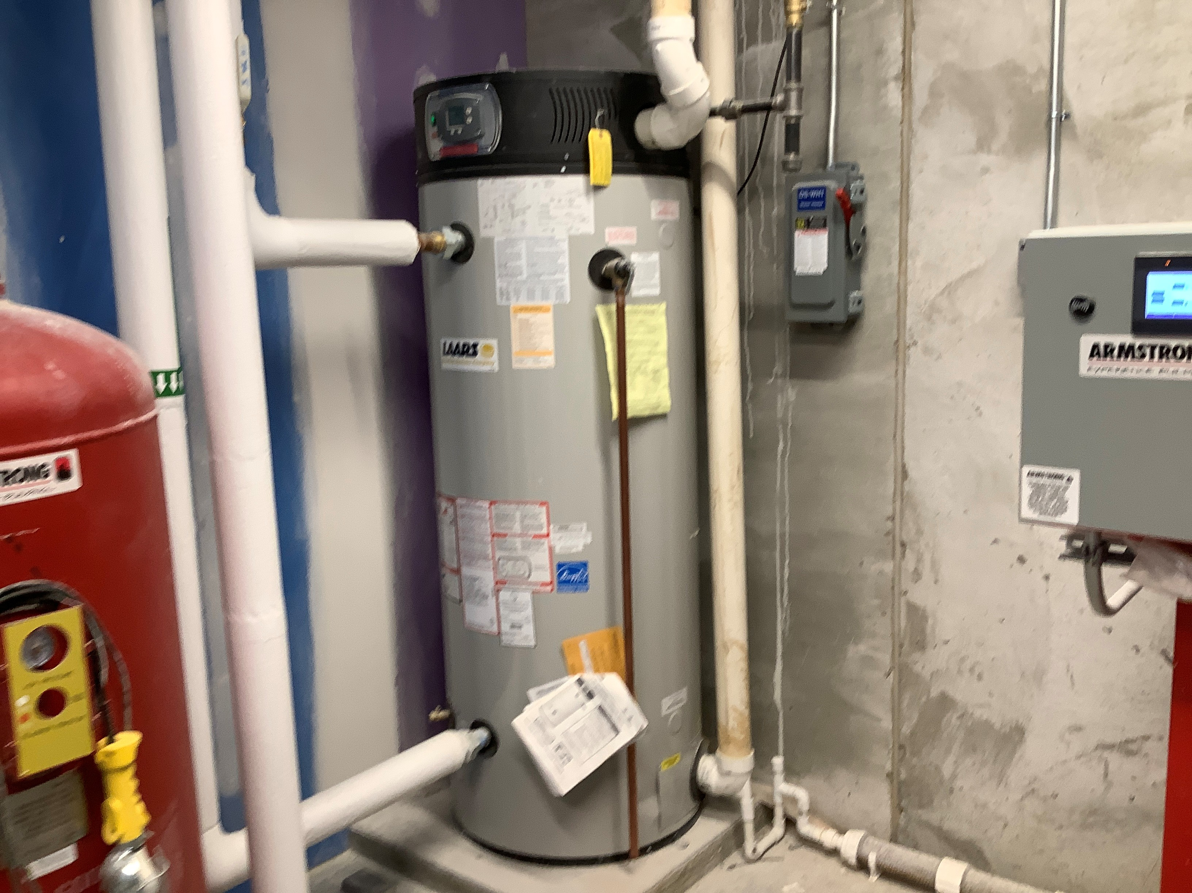
Notes:
A boiler is a water heater that is installed to for space heating purposes, not domestic water use. I think this one is a boiler…

Slide 69
Section 2417.7.3.1 – Abandoned Gas Pipe
Where fuel gas piping is removed from service for an indefinite time period, it shall be purged.
Natural gas rises, propane falls. Either way, it is easy for a substantial amount of gas to remain trapped in sections of piping for long periods of time.
Notes:
The section that required purging last code cycle is still there, but it only ever applied to gas piping over 2 ½” in diameter – so, basically irrelevant in the IRC. This provision applies to all piping, regardless of size or length.

Slide 70
IPC 312.2: Vacuum Test
All DWV piping in commercial occupancies shall be either vacuum tested at -5 psi or tested with not less than a 10’ head of water for not less than 15 minutes. The system shall be tight and leak free at all points.
Plastic piping shall not be tested with air. Check out Charlotte Pipe’s YouTube channel.
Commercial Only

Slide 71
Section 2503.5.2 – Peppermint Test
The smoke and peppermint oil tests have been removed from the code because no one ever uses them anymore.
If you want to use it, it’s not prohibited, they just deleted it because it is outdated and no one cares.

Slide 72
Section 2801.5.3 – Appliances in Pans
Where appliances, equipment or insulation are vulnerable to water damage, such portions of the equipment and insulation shall be installed above the flood level rim of the pan.
Supports located inside the pan to support the appliance or equipment shall be water resistant and approved.

Slide 73
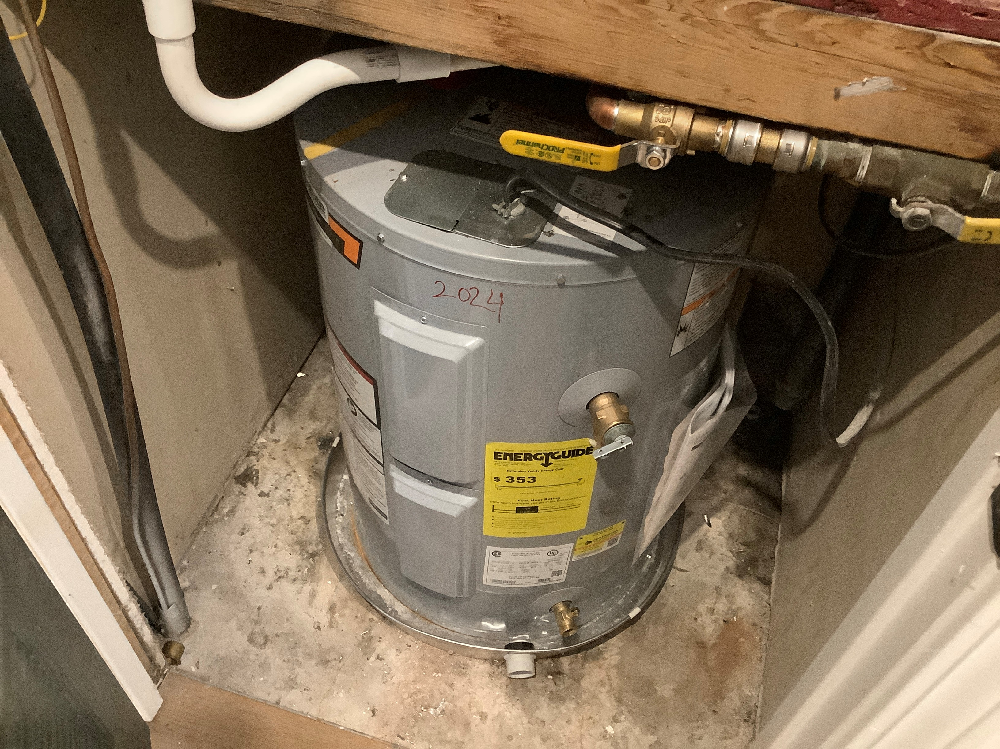

Slide 74
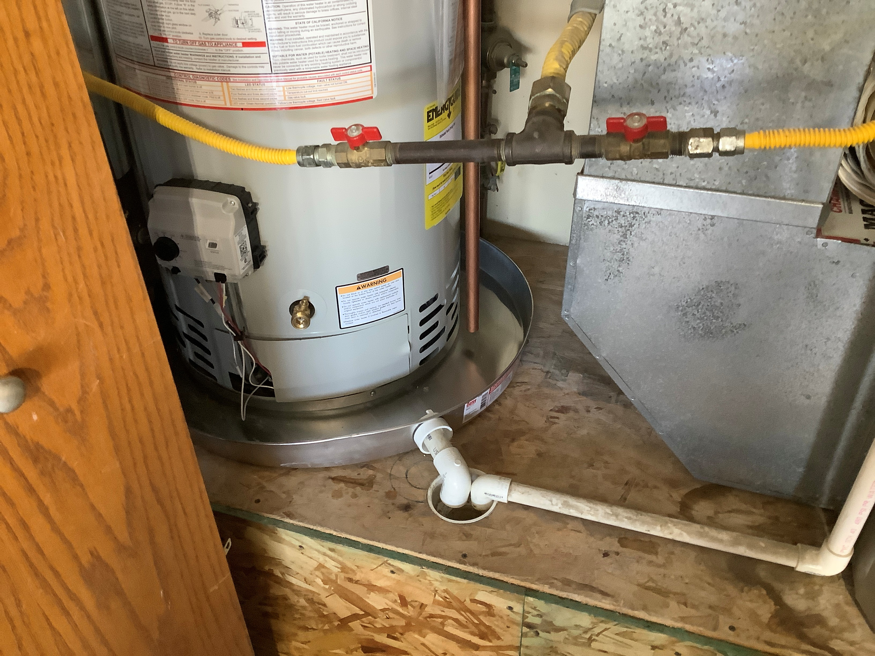

Slide 75

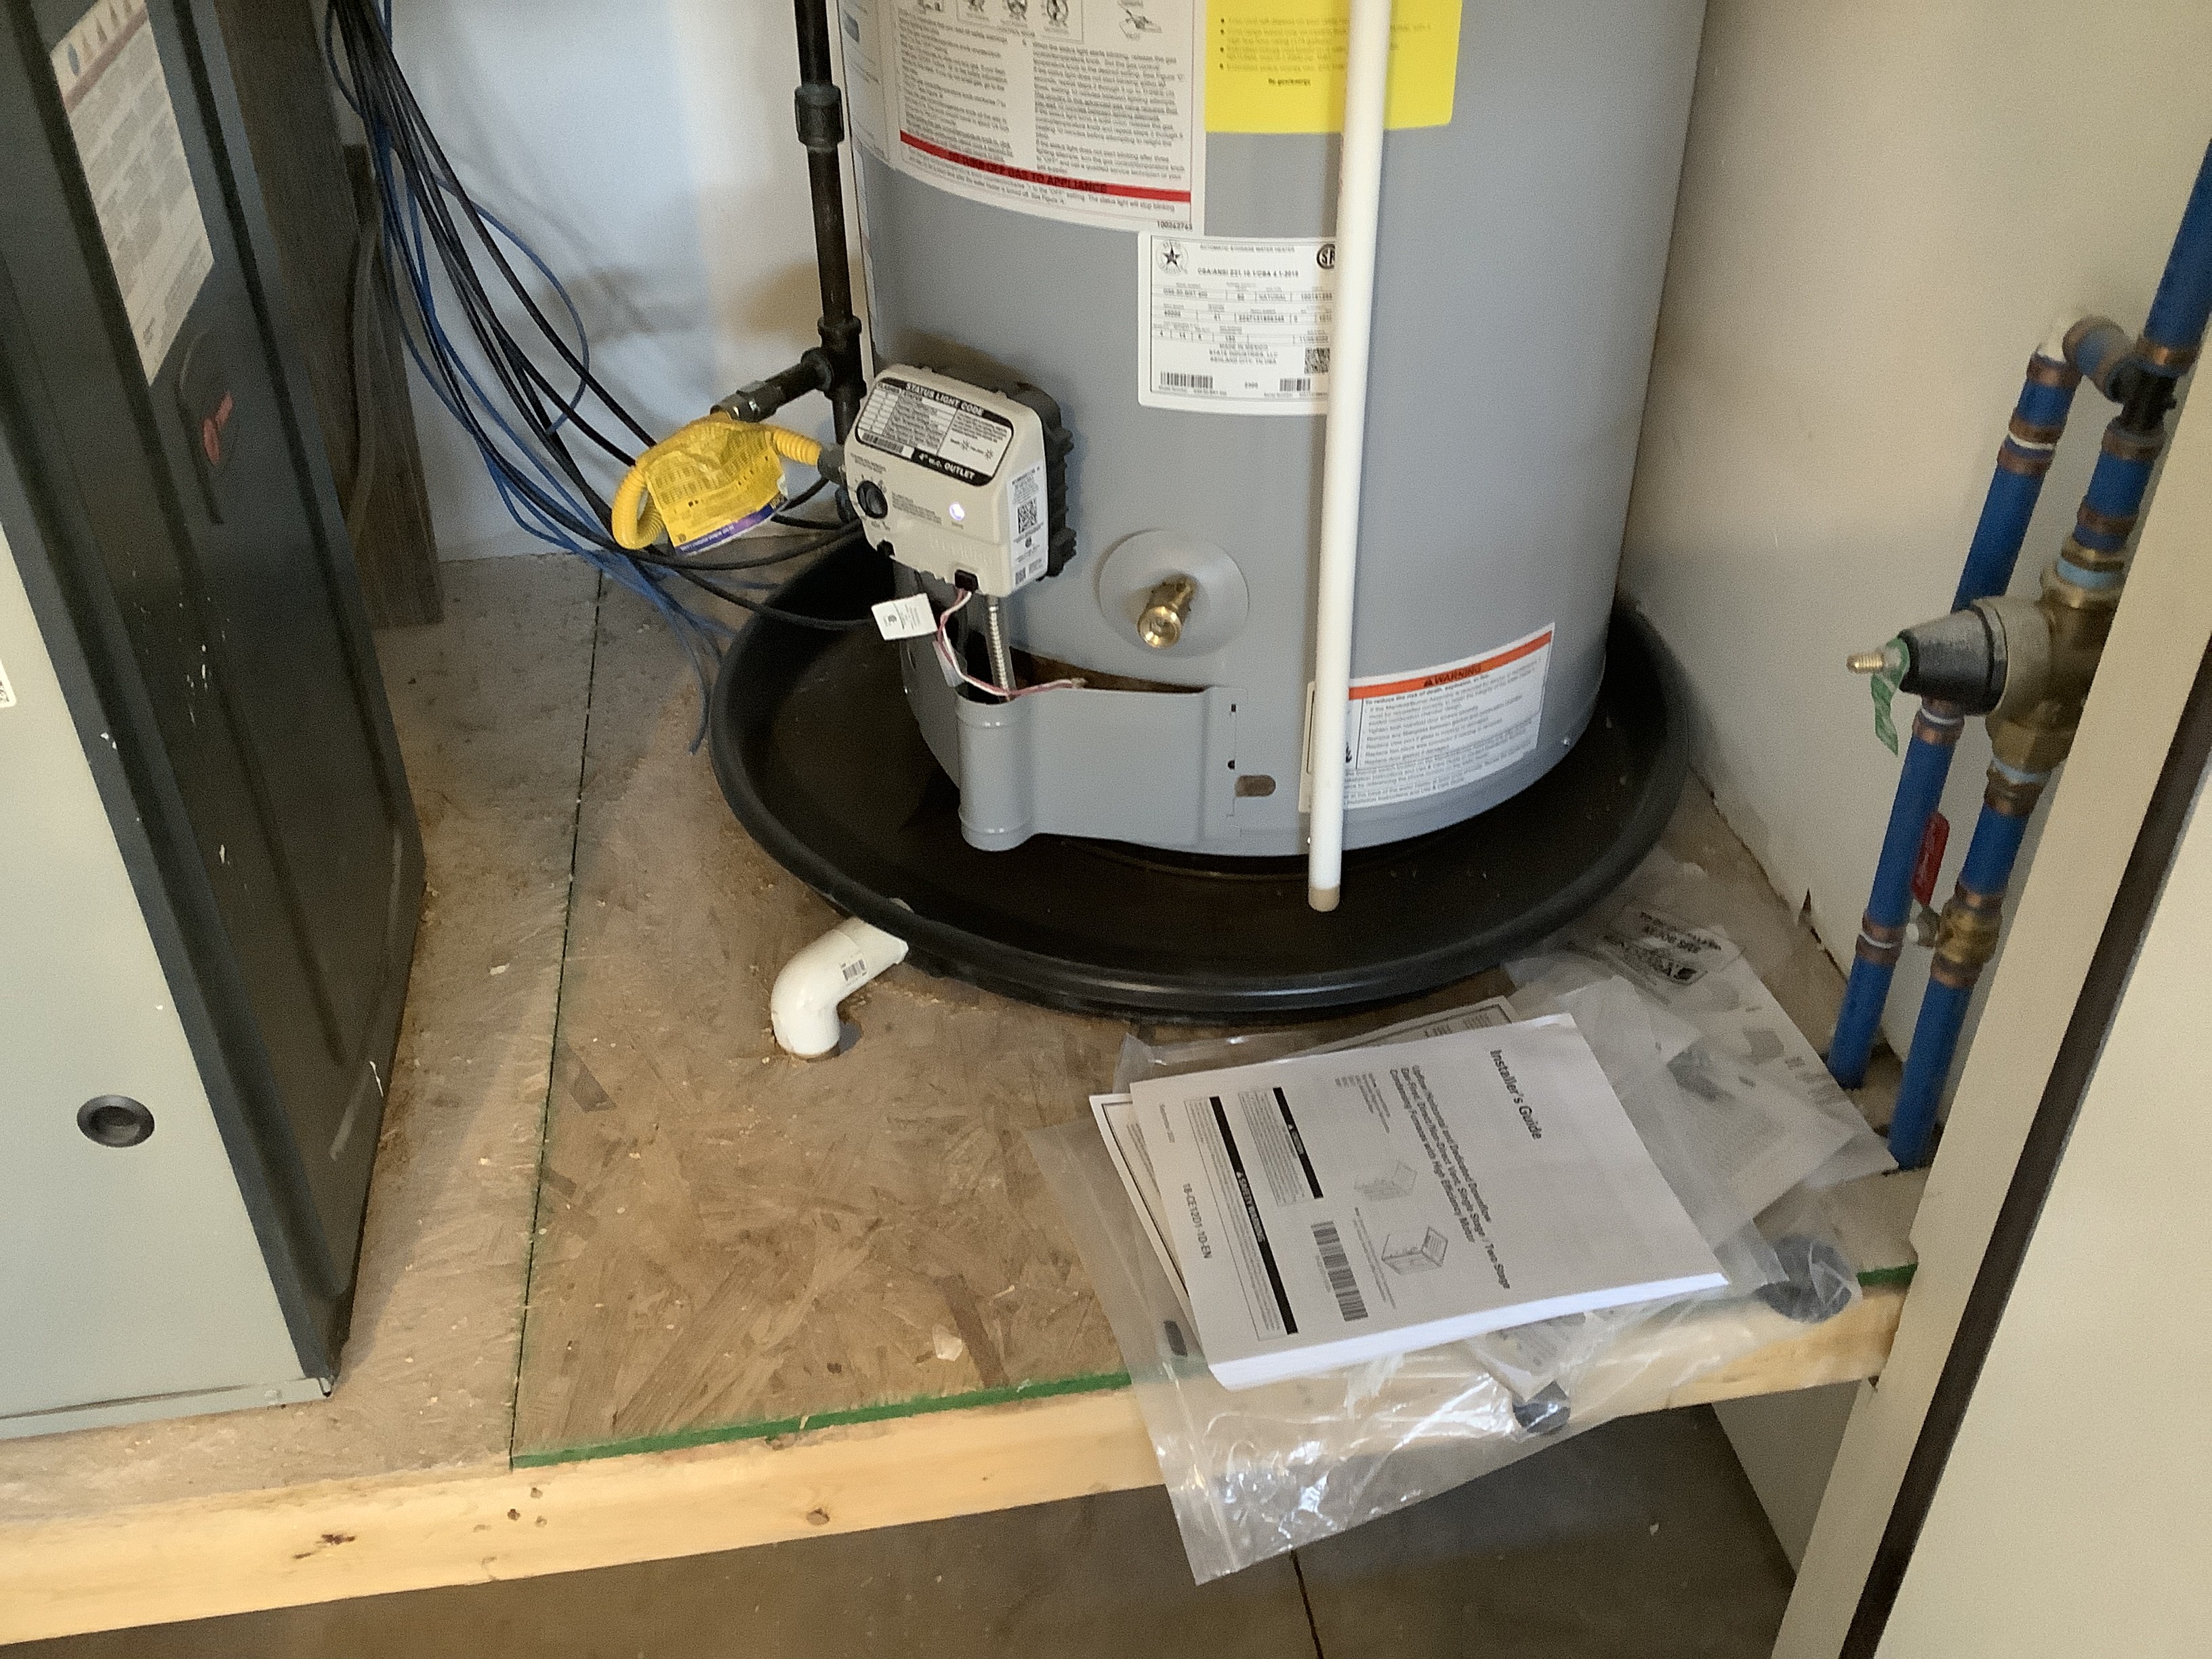
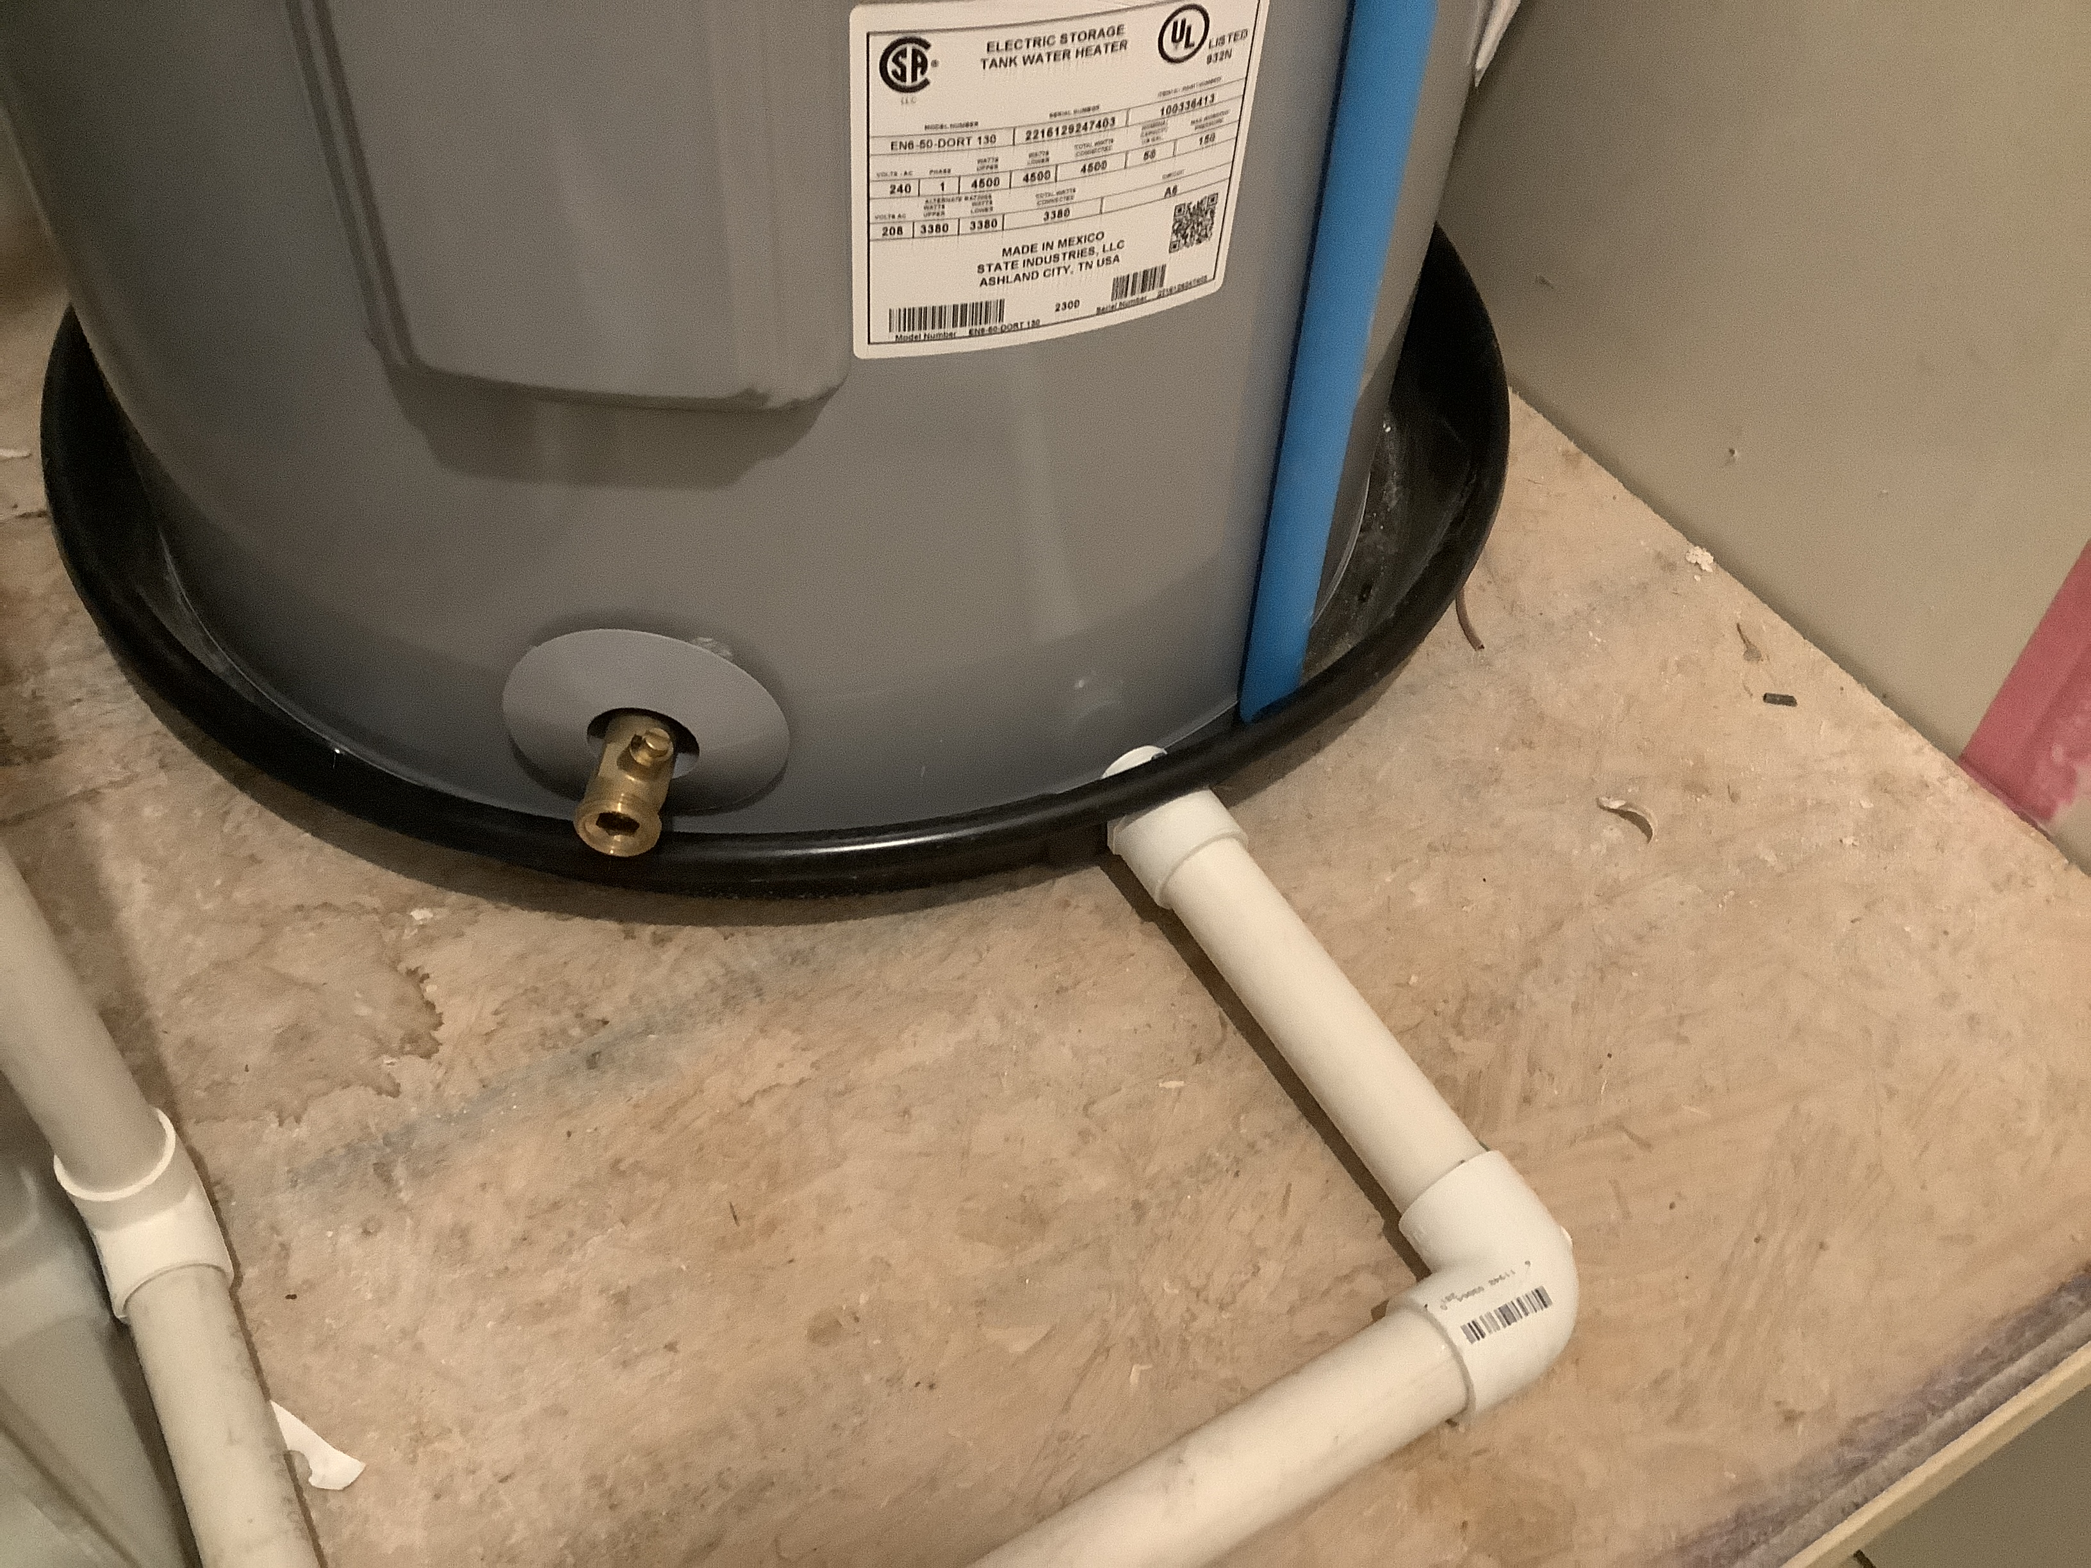

Slide 76
Section 2903.6 – Existing Pipe Ground
Existing metallic water service piping used for electrical grounding shall not be replaced with nonmetallic pipe or tubing until other approved means of grounding is provided.
That metal pipe is likely the most effective ground the electrical system has. A fix will depend on what other grounding already exists. A ground rod may not always work.

Slide 77
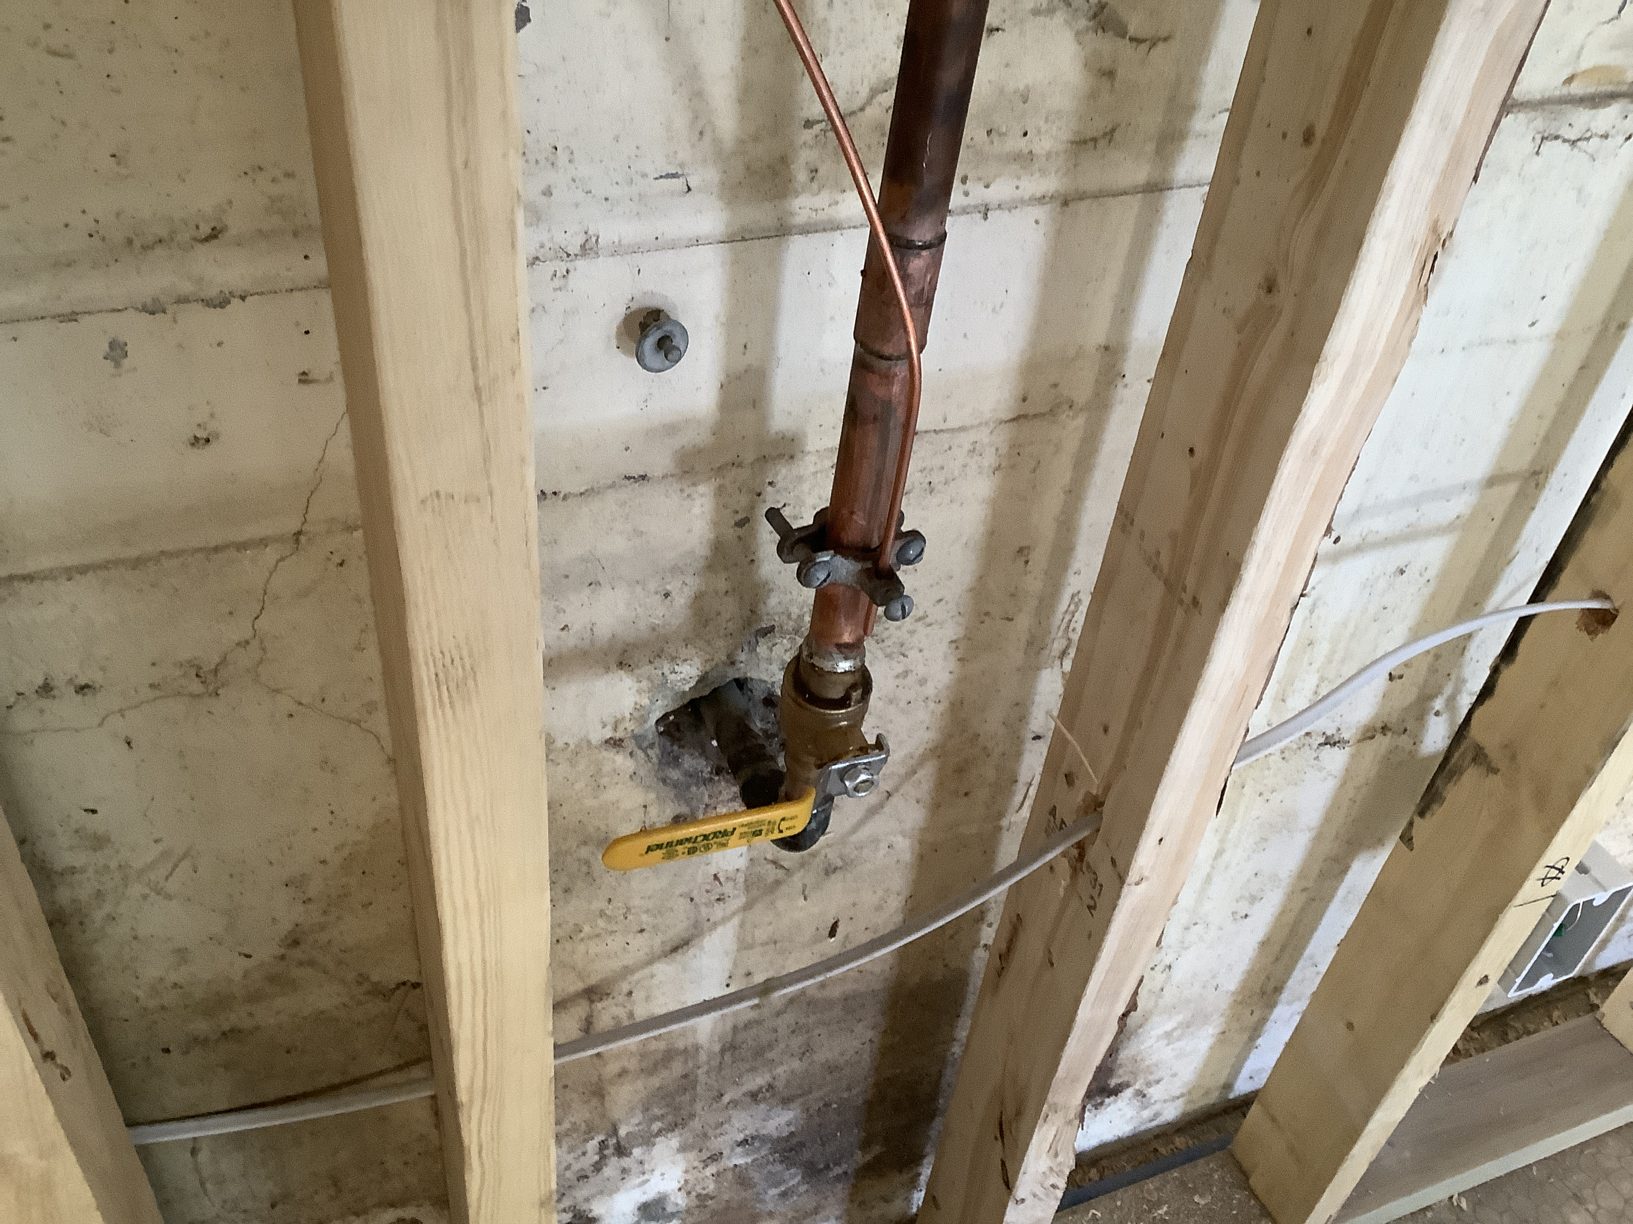
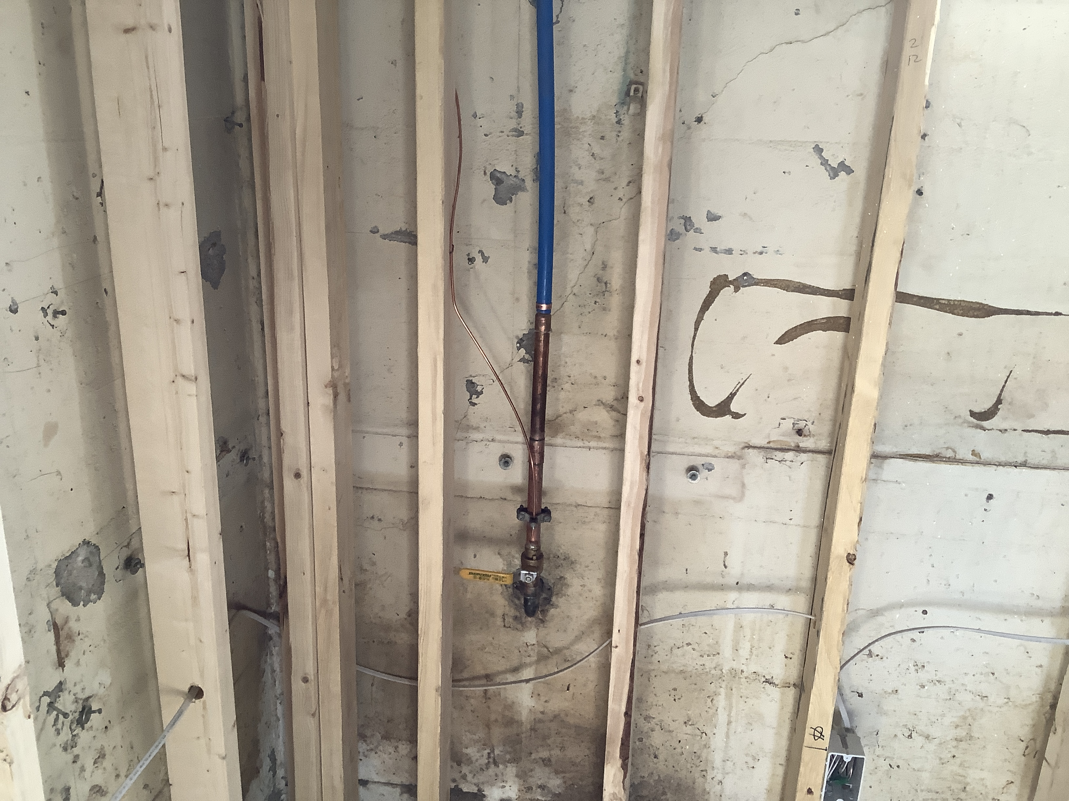
Notes:
Even when PEX is used for most of the house, the water pipe electrode shall be utilized.

Slide 78
Notes:
That clamp must be accessible later, so make the access panel for the ball valve big enough to accommodate both.

Slide 79
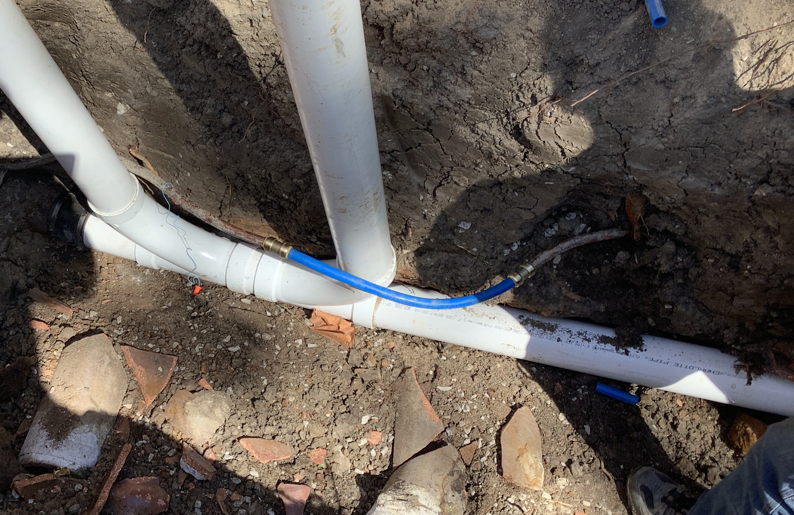
Notes:
Water line repair while digging a sewer, effectively destroying the grounding electrode use of this pipe. You can add a #4 copper bonding jumper between sections of pipe if the service for the building is 200 amps or less, or drive 2 ground rods if a Ufer ground is not available.

Slide 80
IRC – Electrical Section
Already covered in our NEC changes class. Big ticket items:
GFCI provisions will be amended out for 240v.
Island receptacles will stay the same as 2020 NEC.
Surge protectors to protect all new feeders/subpanels.
Pool perimeter bonding will be either copper grid or steel concrete reinforcement, single #6 copper conductor no longer allowed.

Slide 81
Questions?

Slide 82
Current Amendments to the 2021 IRC
2021 IRC- Amendments.pdf

Slide 83
2024 International Building Code
Significant Changes

Slide 84
Minor Changes
Section 105.2 – Work exempt from permit. (Modification)
The exemption from a building permit is no longer applicable to limited-height fences that are utilized as required barriers surrounding swimming pools and spas.
Exemptions from permit requirements of this code shall not be deemed to grant authorization for any work to be done in any manner in violation of the provisions of this code or any other laws or ordinances of this jurisdiction. Permits shall not be required for the following:
2. Fences, other than swimming pool barriers, not over 7 feet high.
WE ARE AMENDING ITEM 2. TO READ “FENCES NOT OVER 7 FEET HIGH”

Slide 85
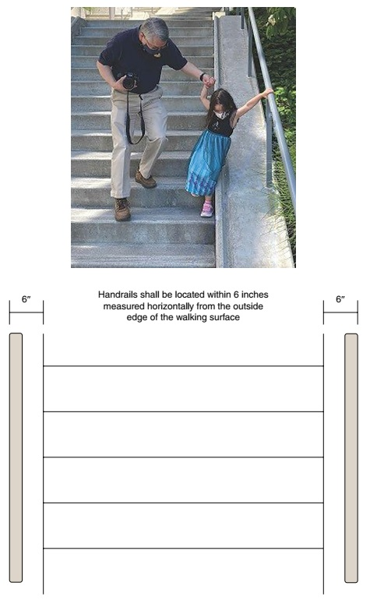
Minor Changes Cont.
Section 718.2.1 – Fireblocking materials. (Addition)
One thickness of 19/32-inch fire-retardant-treated wood structural panel has been added to the listing of materials permitted to be used as fireblocking.
Section 1014.3 – Lateral location of handrails. (Modification)
To ensure that handrails can easily be reached and usable, the code establishes a maximum horizontal distance the handrail can be placed from the walking surface of a stair tread, stepped aisle and ramped aisle.
Handrails located outward from the edge of the walking surface of flights of stairways, ramps, stepped aisles and ramped aisles shall be located 6 inches or less measured horizontally from the edge of the walking surface. Handrails projecting into the width of the walking surface shall comply with Section 1014.9.

Slide 86
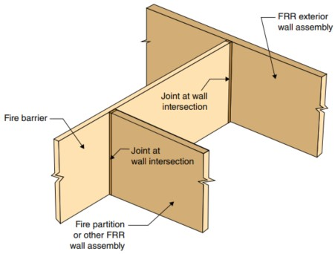
Minor Changes Cont.
Section 707.8 – Fire barrier joints. (Clarification)
Joint requirements now apply to the intersection of fire barriers and other fire-resistance-rated wall assemblies (e.g. smoke barriers) and not solely to exterior wall assemblies. Joints requirements shall comply with Section 715.
Joints made in or between fire barriers, and joints made at the intersection of fire barriers with the underside of a fire-resistance-rated floor or roof sheathing, slab or deck above, and with other fire-resistance-rated wall assemblies shall comply with Section 715.
Joint requirements apply at intersection of fire barriers and other fire-resistance-rated wall assemblies.

Slide 87
411.1 – Puzzle room means of egress.
Modification - Puzzle rooms are no longer required to comply with the provisions applicable to special amusement areas where the means of egress meets the fundamental requirements of Chapter 10.
411.1-General. Special amusement areas having an occupant load of 50 or more shall comply with the requirements for the appropriate Group A occupancy and Sections 411.1 through 411.6 411.7 . Special amusement areas having an occupant load of less than 50 shall comply with the requirements for a Group B occupancy and Sections 411.1 through 411.6 411.7.
Exceptions:
1. Special amusement areas that are without walls or a roof and constructed to prevent the accumulation of smoke need are not required to comply with this section.
2. Puzzle rooms provided with a means of egress that is unlocked, readily identifiable and always available are not required to comply with this section.
Section 411.5 has been deleted
411.5 Puzzle room exiting. Puzzle room exiting shall comply with one of the following:
1.Exiting in accordance with Chapter 10.
2.An alternative design approved by the building official.
3.Exits shall be open and readily available upon activation by the automatic fire alarm system, automatic sprinkler system, and a manual control at a constantly attended location.

Slide 88
Table 509.1 – Incidental Uses
Modification - Storage rooms and waste and linen collection rooms considered as incidental use areas in ambulatory care facilities must now be provided with both automatic sprinkler protection and separation from the remainder of the building with minimum one-hour fire barriers and/or horizontal assemblies.

Slide 89
Table 509.1 – Incidental Uses (Cont.)
Room or Area | Separation and/or Protection
Furnace room where any piece of equipment is over 400,000 Btu per hour input | 1 hour or provide automatic sprinkler system
Rooms with boilers where the largest piece of equipment is over 15 psi and 10 horsepower | 1 hour or provide automatic sprinkler system
Refrigerant machinery room | 1 hour or provide automatic sprinkler system
Hydrogen fuel gas rooms, not classified as Group H | 1 hour in Group B, F, M, S and U occupancies; 2 hours in Group A, E, I and R occupancies.
Incinerator rooms | 2 hours and provide automatic sprinkler system
Paint shops, not classified as Group H, located in occupancies other than Group F | 2 hours; or 1 hour and provide automatic sprinkler system
In Group E occupancies, laboratories and vocational shops not classified as Group H | 1 hour or provide automatic sprinkler system
In Group I-2 occupancies, laboratories not classified as Group H | 1 hour and provide automatic sprinkler system
In ambulatory care facilities, laboratories not classified as Group H | 1 hour or provide automatic sprinkler system
Laundry rooms over 100 square feet | 1 hour or provide automatic sprinkler system
In Group I-2, laundry rooms over 100 square feet | 1 hour and provide automatic sprinkler system
Group I-3 cells and Group I-2 patient rooms equipped with padded surfaces | 1 hour and provide automatic sprinkler system
In Group I-2, physical plant maintenance shops | 1 hour and provide automatic sprinkler system
In ambulatory care facilities or Group I-2 occupancies, waste and linen collection rooms with containers that have an aggregate volume of 10 8.67 cubic feet or greater | 1 hour and provide automatic sprinkler system
In other than ambulatory care facilities and Group I-2 occupancies, waste and linen collection rooms over 100 square feet | 1 hour or provide automatic sprinkler system
In ambulatory care facilities or Group I-2 occupancies, storage rooms greater than 100 50 square feet | 1 hour and provide automatic sprinkler system
Electrical installations and transformers | See Sections 110.26 through 110.34 and Sections 450.8 through 450.48 of NFPA 70 for protection and separation requirements.

Slide 90
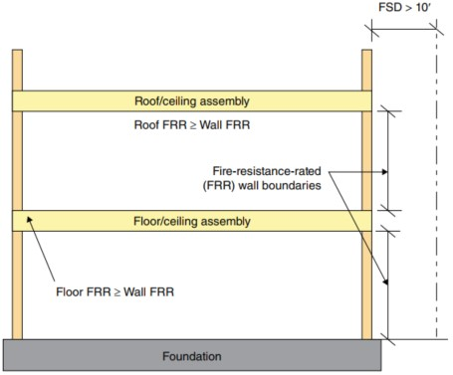
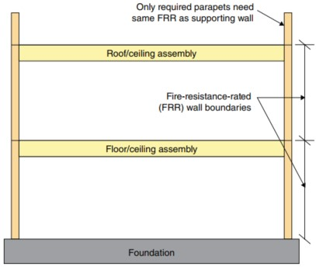
705.6 – Fire rated exterior wall continuity
Modification - Clarity has been provided on how supporting construction for exterior walls is to be fire-resistance-rated, especially in the case of a parapet. Two options have been established for maintaining the vertical continuity of an exterior wall required to be fire-resistance-rated.
705.6 Continuity -The fire-resistance rating of the exterior walls shall extend from the top of the foundation or floor/ceiling assembly below to one of the following:
1. The underside of the floor sheathing, roof sheathing, deck or slab above.
2. The underside of a floor/ceiling or roof/ceiling assembly having a fire-resistance rating equal to or greater than the exterior wall and the fire separation distance is greater than 10 feet.
Parapets shall be provided as required by Section 705.12.

Slide 91
705.7.1 – Floor assemblies in Type III construction.
Addition - Where floor assemblies intersect load-bearing exterior walls in “platform-framed” Type III construction, detailed requirements are now provided for addressing fire-resistance continuity and the use of fire-retardant-treated wood building elements
Section 705.7.1 - In Type III construction where a floor assembly supports gravity loads from an exterior wall, the fire-resistance rating of the portion of the floor assembly that supports the exterior wall shall not be less than the fire-resistance rating required for the exterior wall in Table 601. The fire-resistance rating provided by the portion of the floor assembly supporting and within the plane of the exterior wall shall be permitted to include the contribution of the ceiling membrane when considering exposure to fire from the inside. Where a floor assembly supports gravity loads from an exterior wall, the building elements of the floor construction within the plane of the exterior wall, including but not limited to, rim joists, rim boards and blocking, shall be in accordance with the requirements for interior building elements of Type III construction.

Slide 92
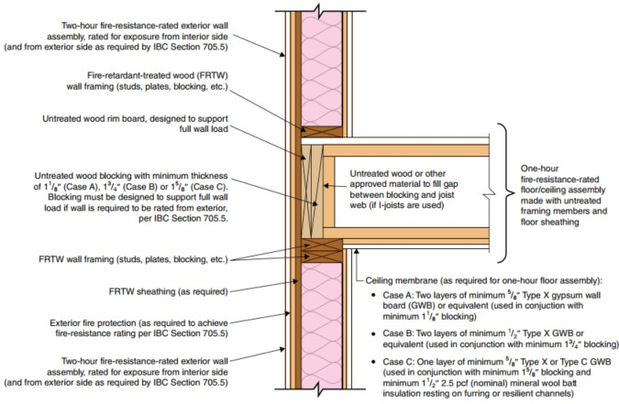
705.7.1 – Cont.

Slide 93
716.2.6.1 – Fire door closing for storm shelters.
Modification - Fire doors required solely for compliance with ICC 500 regulated storm shelters are no longer required to be self-closing or automatic-closing.
Section 716.2.6.1 - Fire doors shall be latching and self- or automatic-closing in accordance with this section.
Exceptions:
1.Fire doors located in common walls separating dwelling units or sleeping units in Group R-1 shall be permitted without automatic- or self-closing devices.
2.The elevator car doors and the associated elevator hoistway enclosure doors at the floor level designated for recall in accordance with Section 3003.2 shall be permitted to remain open during Phase I emergency recall operation.
3.Fire doors required solely for compliance with ICC 500 shall not be required to be self-closing or automatic-closing.

Slide 94
717.2.4 – Mechanical, electrical and plumbing controls.
Addition – Wiring and cabling is not permitted to be run through fire dampers, smoke dampers, combination fire/smoke dampers, and ceiling radiation dampers to allow for proper operation of the device during inspections and fire events.
Section 717.2.4 – Mechanical, electrical and plumbing controls shall not be installed in air duct systems.
Exception: Controls where the wiring is directly associated with the air distribution system. The wiring shall comply with the requirements of Section 602 of the IMC and be as short as practicable.
717.2.4.1 – Controls not permitted to be installed through dampers.
Section 717.2.4.1 – Mechanical, electrical and plumbing controls shall not be installed through fire dampers, smoke dampers, combination fire/smoke dampers or ceiling radiation dampers unless otherwise permitted by the manufacturer and the listing.

Slide 95
1010.2.1 - Unlatching
Modification - New definitions of various types of bolting mechanisms and a new table clarify the types and locations for locks and latches.
Definitions added to Section 202
AUTOMATIC FLUSH BOLT. Door-locking hardware, installed on the inactive leaf of a pair of doors, which has a bolt that is extended automatically into the door frame or floor when the active leaf is closed after the inactive leaf, and which holds the inactive leaf in a closed position. When the active leaf is opened, the automatic flush bolt retracts the bolt or rod allowing the inactive leaf to be opened (see “Constant latching bolt,” “Dead bolt,” “Manual bolt”).
CONSTANT LATCHING BOLT. Door-locking hardware installed on the inactive leaf of a pair of doors consisting of a bolt that automatically latches into the door frame or floor, holding the inactive leaf in a closed position. The latch bolt is retracted manually to allow the inactive leaf to be opened.
DEAD BOLT. Door-locking hardware with a bolt which is extended and retracted by action of the lock mechanism (see “Automatic flush bolt,” “Constant latching bolt,” “Manual bolt”).
MANUAL BOLT. Door-locking hardware operable from one side of the door, or from the edge of a door leaf, with a bolt or rod extended and retracted by manual movement of the bolt or rod, such as a manual flush bolt or manual surface bolt (see “Automatic flush bolt,” “Constant latching bolt, “Dead bolt”).

Slide 96
1010.2.1 – Unlatching - Cont.
Section 1010.2.1 - The unlatching of any door or leaf for egress shall require not more than one motion in a single linear or rotational direction to release all latching and all locking devices. Manual bolts are not permitted.
1.Places of detention or restraint.
2.Where manually operated bolt locks are permitted by Section 1010.2.5.
3.Doors with automatic flush bolts as permitted by Section 1010.2.4, Item 4.
2.Doors with manual bolts, automatic flush bolts and constant latching bolts as permitted by Section 1010.2.4, Item 4.
3.Doors from individual dwelling units and sleeping units of Group R occupancies as permitted by Section 1010.2.4, Item 5.

Slide 97
1010.2.4 - Locks and latches (Locally Amended)
Modification – A new table to clarify the types and locations for locks and latches.
Section 1010.2.4 – Locks and latches shall be permitted to prevent the operation of doors where any of the following exist:
(No changes to Items 1 & 2)
3. - In buildings in occupancy Group A having an occupant load of 300 or less, Groups B, F, M and S, and in places of religious worship, the main door or doors are permitted to be equipped with a thumb-turn operated locking devices from the egress side provided:
3.1 The doors are the main exterior doors to the building, or the doors are the main doors to the tenant space.
3.2. The locking device is readily distinguishable as locked.
3.3 A readily visible durable sign is posted on the egress side on or adjacent to the door stating: THIS DOOR TO REMAINUNLOCKED WHEN THIS SPACE IS OCCUPIED. The signs hall be in letters 1-inch high on a contrasting background.
4. Where egress doors are used in pairs, approved automatic flush bolts shall be permitted to be used, provided that the door leaf having the automatic flush bolts does not have a doorknob or surface-mounted hardware. Manual bolts, automatic flush bolts, and constant latching bolts on the inactive leaf of a pair of doors in accordance with Table 1010.2.4, provided the inactive leaf does not have a doorknob, panic hardware, or similar operating hardware.
5. Doors Single exit doors complying with Section 1006.2.1 or 1006.3.4 from individual dwelling or sleeping units of Group R occupancies having an occupant load of 10 or less are permitted to be and equipped with a night latch, dead bolt or security chain that requires a second releasing motion, provided such devices are openable from the inside without theuse of a key or tool.
(No changes in LOCAL AMENDMENTS Items 6 through 10)

Slide 98
Table 1010.2.4
Application With a Pair of Doors With an Active Leaf and an Inactive Leaf | The Pair of Doors Are Required to Comply With Section 716 | Permitted Uses of Manual Bolts, AutomaticFlush Bolts and Constant Latching Bolts onthe Inactive Leaf of a Pair of Doors
 |  | Surface- orflush-mountedmanual bolts | Automaticflush bolts | Constantlatching bolts
Group B, F or S occupancies with occupant load less than 50. | No | P | P | P
 | Yes | NP | NP^{b} | P
Group B, F or S occupancies where the building is equipped with automatic sprinkler system in accordance with Section 903.3.1.1 and the inactive leaf is not needed to meet egress capacity requirements. | No | P | P | P
 | Yes | NP | NP^{b} | P
Group I-2 patient care and sleeping rooms where inactive leaf is not needed to meet egress capacity requirements. | No | NP | NP^{b} | P
 | Yes | NP | NP^{b} | P
Any occupancy where panic hardware is not required, egress doors are used in pairs, and where both leaves are required to meet egress capacity requirements. | No | NP | P | NP
 | Yes | NP | NP^{b} | NP
Storage or equipment rooms where the inactive leaf is not needed to meet egress capacity requirements. | No | Pª | P | P
 | Yes | Pª | P | P
P = Permitted. NP = Not permitted,
a.Not permitted on corridor doors in Group I-2 occupancies where corridor doors are required to be positive latching.
b.Permitted where both doors are self-closing or automatic-closing, and are provided with a coordinator that causes the inactive leaf to be closed prior to the active leaf.

Slide 99
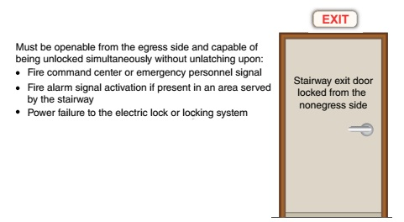
1010.2.6 – Stairway doors.
Modification- Where stairway doors are locked from the nonegress side, additional unlocking requirements are now required. Exception 3 has been modified.
Section 1010.2.7 1010.2.6 – Interior stairway means of egress doors shall be openable from both sides without the use of special knowledge or effort.
Exceptions:
3. Stairway exit doors are permitted shall not be locked from the side opposite the egress side, provided that unless they are openable from the egress side and capable of being unlocked simultaneously without unlatching upon by any of the following methods;
3.1. Shall be capable of being unlocked individually or simultaneously without unlatching upon a signal from the fire command center, where present, or a signal by emergency personnel from a single location inside the main entrance to the building.
3.2. Shall unlock simultaneously upon activation of a fire alarm signal when a fire alarm system is present in an area served by the stairway.
3.3. Shall unlock upon failure of the power supply to the electric lock or the locking system.

Slide 100
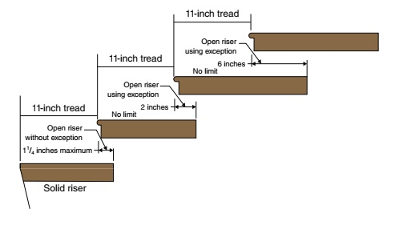
1011.5.5.1 – Nosing projections size.
Modification - Where open risers are permitted, a new exception permits the stairway nosing to extend a greater distance over the stair tread below.
Section 1011.5.5.1 – The leading edge (nosings) of treads nosings shall project not more than 1-1/4 inches beyond the tread below.
Exception: When solid risers are not required, the nosing projection is permitted to exceed the maximum projection.

Slide 101
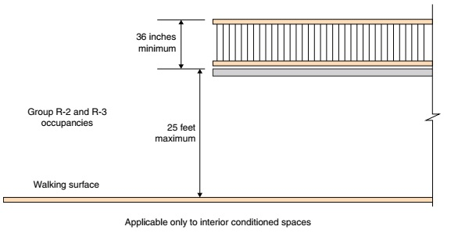
1015.3 – Guardrail Height within dwelling units
Modification – An additional exception for minimum guard heights has been added for interior locations within Group R-2 and R-3 individual dwelling units.
Section 1015.3 Height. Required guards shall be not less than 42 inches high, measured vertically as follows:
1.From the adjacent walking surfaces.
2.On stairways and stepped aisles, from the line connecting the leading edges of the tread nosings.
3.On ramps and ramped aisles, from the ramp surface at the guard.
Exceptions:
2. For occupancies in Groups R-2 and R-3, within the interior conditioned space of individual dwelling units, where the open-sided walking surface is located not more than 25 feet measured vertically to the floor or walking surface below, required guards shall not be less than 36 inches in height measured vertically above the adjacent walking surface.

Slide 102
1807.2.5 – Guards at retaining walls.
Addition – New provisions for guards on retaining walls are added consistent with guard requirements elsewhere in the code.
Section 1807.2.5 - Guards shall be provided at retaining walls in accordance with Sections 1807.2.5.1 through 1807.2.5.3.
Exception: Guards are not required at retaining walls not accessible to the public.
Section 1807.2.5.1 - Where required. At retaining walls located within 36 inches of walking surfaces, a guard shall be required between the walking surface and the open side of the retaining wall where the walking surface is located more than 30 inches measured vertically to the surface or grade below at any point within 36 inches horizontally to the edge of the open side. Guards shall comply with Section 1607.9.
Section 1807.2.5.2 - Height. Required guards at retaining walls shall comply with the height requirements of Section 1015.3.
Section 1807.2.5.3 - Opening limitations. Required guards shall comply with the opening limitations of Section 1015.4.

Slide 103
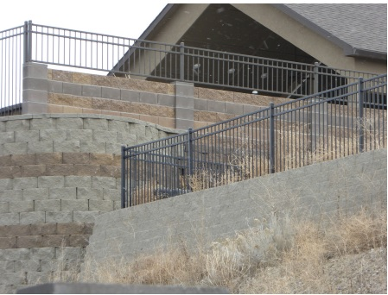
Guards at retaining walls.

Slide 104
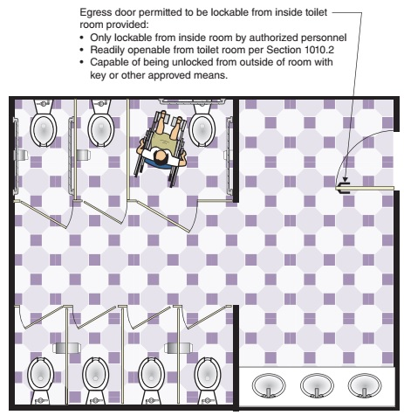
2902.3.6 - Multiple User Restroom Door Locking
Modification – In a multiple user toilet room, the egress door is now permitted to be lockable from the interior side provided three specified conditions are met.
Section 2902.3.6 - Where a toilet facility is provided for the use of multiple occupants, the egress door for the room shall not be lockable from the inside of the room. This section does not apply to family or assisted-use toilet facilities.
Exception: The egress door of a multiple occupant toilet room shall be permitted to be lockable from inside the room where all the following criteria are met:
1.The egress door shall be lockable from the inside of the room only by authorized personnel by the use of a key or other approved means.
2.The egress door shall be readily openable from the toilet room in accordance with Section 1010.2
3.The egress door shall be capable of being unlocked from outside the room with a key or other approved means.

Slide 105
3111.3.5.2 – Photovoltaic panels installed over a roof assembly.
Addition – New provisions have been added to Section 3111 in order to establish appropriate fire testing and listing criteria for overhead photovoltaic support structures that could have people or vehicles in space beneath them.
Section 3111.3.5.1 – Elevated PV support structures with PV panels installed over open-grid framing or over a noncombustible deck shall have PV panels tested, listed and labeled with a fire type rating in accordance with UL 1703 or with both UL 61730-1 and UL 67130-2. Photovoltaic panels marked “not fire rated” shall not be installed on elevated PV support structures.
Section 311.3.5.2 – Elevated PV support structures with a PV panel system installed over a roof assembly shall have a fire classification in accordance with Section 1505.9.

Slide 106
Appendix P - Sleeping Lofts
Addition - New Appendix P sets forth the scoping limitations and technical criteria for sleeping lofts that are provided within Group R dwelling units and sleeping units.
Section P101.1. - Where provided in Group R occupancies, sleeping lofts shall comply with the provisions of this code, except as modified by this appendix. Sleeping lofts constructed in compliance with this appendix shall be considered a portion of the story below. Such sleeping lofts shall not contribute to either the building area or number of stories as regulated by Section 503.1. The sleeping loft floor area shall be included in determining the fire area.
The following sleeping lofts are exempt from compliance with this appendix:
1.Sleeping lofts with a maximum depth of less than 3 feet (914 mm).
2.Sleeping lofts with a floor area of less than 35 square feet (3.3 m2).
3.Sleeping lofts not provided with a permanent means of egress.

Slide 107
Appendix P - Sleeping Lofts – Cont.
Section P101.2 - Sleeping loft limitations. Sleeping lofts shall comply with the following:
1.The sleeping loft floor area shall be less than 70 square feet (6.5 m2).
2.The sleeping loft ceiling height shall not exceed 7 feet (2134 mm) for morethan one-half of the sleeping loft floor area.
The provisions of this appendix shall not apply to sleeping lofts that do not comply with Items 1 and 2.
Section P101.3 - Sleeping loft ceiling height. The clear height below the sleeping loft floor construction shall be not less than 7 feet (2134 mm). The ceiling height above the finished floor of the sleeping loft shall be not less than 3 feet (914 mm). Portions of the sleeping loft with a sloped ceiling measuring less than 3 feet (914 mm) from the finished floor to the finished ceiling shall not contribute to the sleeping loft floor area.
Section P101.4 - Sleeping loft area. The aggregate area of all sleeping lofts and mezzanines within a room shall comply with Section 505.2.1.
Exception: The area of a single sleeping loft shall not be greater than twothirds of the area of the room in which it is located, provided that no other sleeping lofts or mezzanines are open to the room in which the sleeping loft is located.

Slide 108
Appendix P - Sleeping Lofts – Cont.
Section P103.1 -Where a permanent means of egress is provided for sleeping lofts, the means of egress shall comply with Chapter 10 of this code, as modified by Sections P103.2 through P103.6.
Section P103.2 - A minimum ceiling height of 3 feet (914 mm) shall be provided for the entire width of the means of egress from the sleeping loft.
Section P103.3 - Stairways providing egress from sleeping lofts shall be permitted to comply with Sections P103.3.1 through P103.3.3.
Section P103.3.1 - Stairways providing egress from a sleeping loft shall not be less than 17 inches (432 mm) in clear width at or above the handrail. The width below the handrail shall be not less than 20 inches (508 mm).
Section P103.3.2 - Risers for stairs providing egress from a sleeping loft shall be not less than 7 inches (178 mm) and not more than 12 inches (305 mm) in height. Tread depth and riser height shall be calculated in accordance with one of the following formulas:
1.The tread depth shall be 20 inches (508 mm) minus four-thirds of the riser height.
2.The riser height shall be 15 inches (381 mm) minus three-fourths of the tread depth.
Section P103.3.3 - Landings at stairways providing egress from sleeping lofts shall comply with Section 1011.6, except that the depth of landings in the direction of travel shall be not less than 24 inches (610 mm).
Section P103.4 - Alternating tread devices shall be permitted as a means of egress from sleeping lofts, where the sleeping loft floor is not more than 10 feet (3048 mm) above the floor of the room to which it is open. Handrails and treads of such alternating tread devices shall comply with Section 1011.14.

Slide 109
Appendix P - Sleeping Lofts – Cont.
Section P103.5 - Ship’s ladders. Ship’s ladders shall be permitted as a means of egress from sleeping lofts where the sleeping loft floor is no more than 10 feet above the floor of the room to which it is open. Handrails and treads of such ship’s ladders shall comply with Section 1011.15.
Section P103.6 - Ladders shall be permitted as a means of egress from sleeping lofts where the sleeping loft floor is not more than 10 feet above the floor of the room to which it is open. Such ladders shall comply with Sections P103.6.1 and P103.6.2.
Section P103.6.1 - Ladders providing egress from sleeping lofts shall have a rung width of not less than 12 inches and 10-inch to 14-inch spacing between rungs. Ladders shall be capable of supporting a 300-pound load on any rung. Rung spacing shall be uniform within 3/8 inch.
Section P103.6.2 - Ladders shall be inclined at 70 to 80 degrees from horizontal.

Slide 110
Appendix P - Sleeping Lofts – Cont.
Section P104.1 - Guards complying with Section 1015 of this code shall be provided at the open sides of sleeping lofts.
Exception: The guard height at sleeping lofts shall be permitted to be 36 inches where the ceiling height of the sleeping loft is 42 inches or less.
Section P105.1 - Listed single- or multiple-station smoke alarms complying with UL 217 shall be installed in all sleeping lofts.

Slide 111
2024 International Existing Building Code Significant Changes

Slide 112
104 - Code Official Duties
Modification – Included in an overall reformat of Section 104, Regulating duties of the code official, the approach for reviewing for code compliance has been significantly updated to reflect the current manner that alternate materials, designs and methods are evaluated.
Revised and clarified the provisions for review and approval of alternative methods to be consistent across all I-Codes and fit modern terminology and approaches.
Added provision to authorize the code official to require a peer review of alternative methods

Slide 113
303 - Storm Shelters
Modification – The storm shelter section is updated for clarity and now includes provisions for evaluation, maintenance and repair, and a definition of “storm shelter” is added.
Section 303.1.1 – Storm shelters shall be constructed in accordance with Section 423 of the IBC and ICC 500 and shall be designated as hurricane shelters, tornado shelters or combined hurricane and tornado shelters.
Exception:
Storm shelters added to critical emergency operations facilities or Group E occupancies are not required to comply with the travel distance in Section 423.4.2 pr 423.5.2 of the IBC.
STORM SHELTER – A building, structure or portions thereof, constructed in accordance with ICC 500, designated for used during hurricanes, tornadoes or other sever windstorms.

Slide 114
401.2 - Work on nondamaged components
Addition – Portions of a building that are repaired or replaced as part of a repair are not considered an alteration.
Section 401.2 – The work shall not make the building less compliant than it was before the repair was undertaken. Work on nondamaged components that is necessary for the required repair of damaged components shall be considered part of the repair and shall not be subject to requirements for alterations.
Notes:
Repairs cannot decrease the level of safety in a building

Slide 115
405.1 - Concrete repairs
Addition – American Concrete Institute (ACI) 562 is referenced in the 2024 IEBC for concrete repairs.
Section 405.1.1 – Repair of structural concrete shall be permitted to comply with ACI 562 Section 1.7, except where Section 405.2.2, 405.2.3 or 405.2.4.1 requires compliance with Section 304.3.
Section 405.2.2 dictates structural concrete can be repaired according to ACI 562 unless substantially damaged by an earthquake or in SDC D, E, F

Slide 116
502.1.2 – Creation or extension of nonconformity
Addition – Additions to cannot create or extend any nonconformity in the existing building.
Accessibility
Structural Strength
Supports/Attachments for nonstructural components
Fire Safety
Means of Egress
Capacity of mechanical, plumbing or electrical systems.

Slide 117
908 – Emergency responder communication system
Addition - An existing building undergoing extensive alterations will now require evaluation of the emergency responder communication enhancement system coverage to ensure compliance with the IFC.
Section 908.1 - The existing building shall undergo an evaluation of the emergency responder communication signal strength and coverage area within the entire building in accordance with 908.1.1 and 908.1.2.
Exception:
Where it is determined by the fire code official that the emergency responder communication enhancement system (ERCES) is not needed.
Section 908.1.1 - The evaluation shall determine the current signal strength and coverage capabilities of the public safety communication systems utilized by the jurisdiction, measured at the exterior of the building.
Section 908.1.2 - The evaluation report shall be submitted for approval by the fire code official and the frequency license holder. Where the coverage area, signal strength or DAQ does not comply with Section 510 of the International Fire Code, the existing building shall be provided with ERCES coverage. The fire code official is authorized to establish the timeframe for such installation or modification.

Slide 118
1011.2.1 – Removal of sprinkler systems
Addition - Conditions for removal of automatic sprinkler systems are added to the code, which permits the code official to authorize removal of an existing automatic sprinkler system.
Section 1011.2.1.1 - The code official is authorized to permit the removal of an existing automatic sprinkler system where all of the following conditions exist:
1. The system is not required for new construction.
2. Portions of the system that are exposed to the public are removed.
3. The system was not installed as part of any special construction features, including fire-resistance-rated assemblies and smoke-resistive assemblies, conditions of occupancy, means of egress conditions, fire code deficiencies, approved modifications or approved alternative materials, design and methods of construction, and equipment applying to the building.
Section 1011.2.1.1.1 - Plans, investigation and evaluation reports, and other data shall be submitted documenting compliance with Section 1011.2.1.1 for review and approval in support of a determination authorizing the removal of the automatic sprinkler system by the code official.

Slide 119
2024 International Fire Code Significant Changes
Jake Powell, Fire Marshal

Slide 120
Sprinkler & Alarm Systems for Li-Ion batteries
Addition
New thresholds for when a sprinkler system is required for;
Group B – Research & development labs
Group F-1 – All battery or vehicle manufacturing
Group M – storage rooms where required by section 320 or chapter 32
Group S-1 – Storage or repair of EVs where the fire area is > 500 sq. ft.
New required fire detection for;
Laboratories, manufacturing, and storage where required by section 320

Slide 121
Carbon Monoxide Detection
Addition
Required in all occupancies containing a carbon monoxide source
Exception for group S, F, and U occupancies
Clarified language in all the carbon monoxide sections
CO alarms are to only be used in dwellings and sleeping units
All other occupancies are required to have a CO detection system either tied to the fire alarm if required or a CO alarm system.
Retroactively requires CO alarms in all buildings
Battery powered CO alarms are allowed in existing buildings

